Slide 1
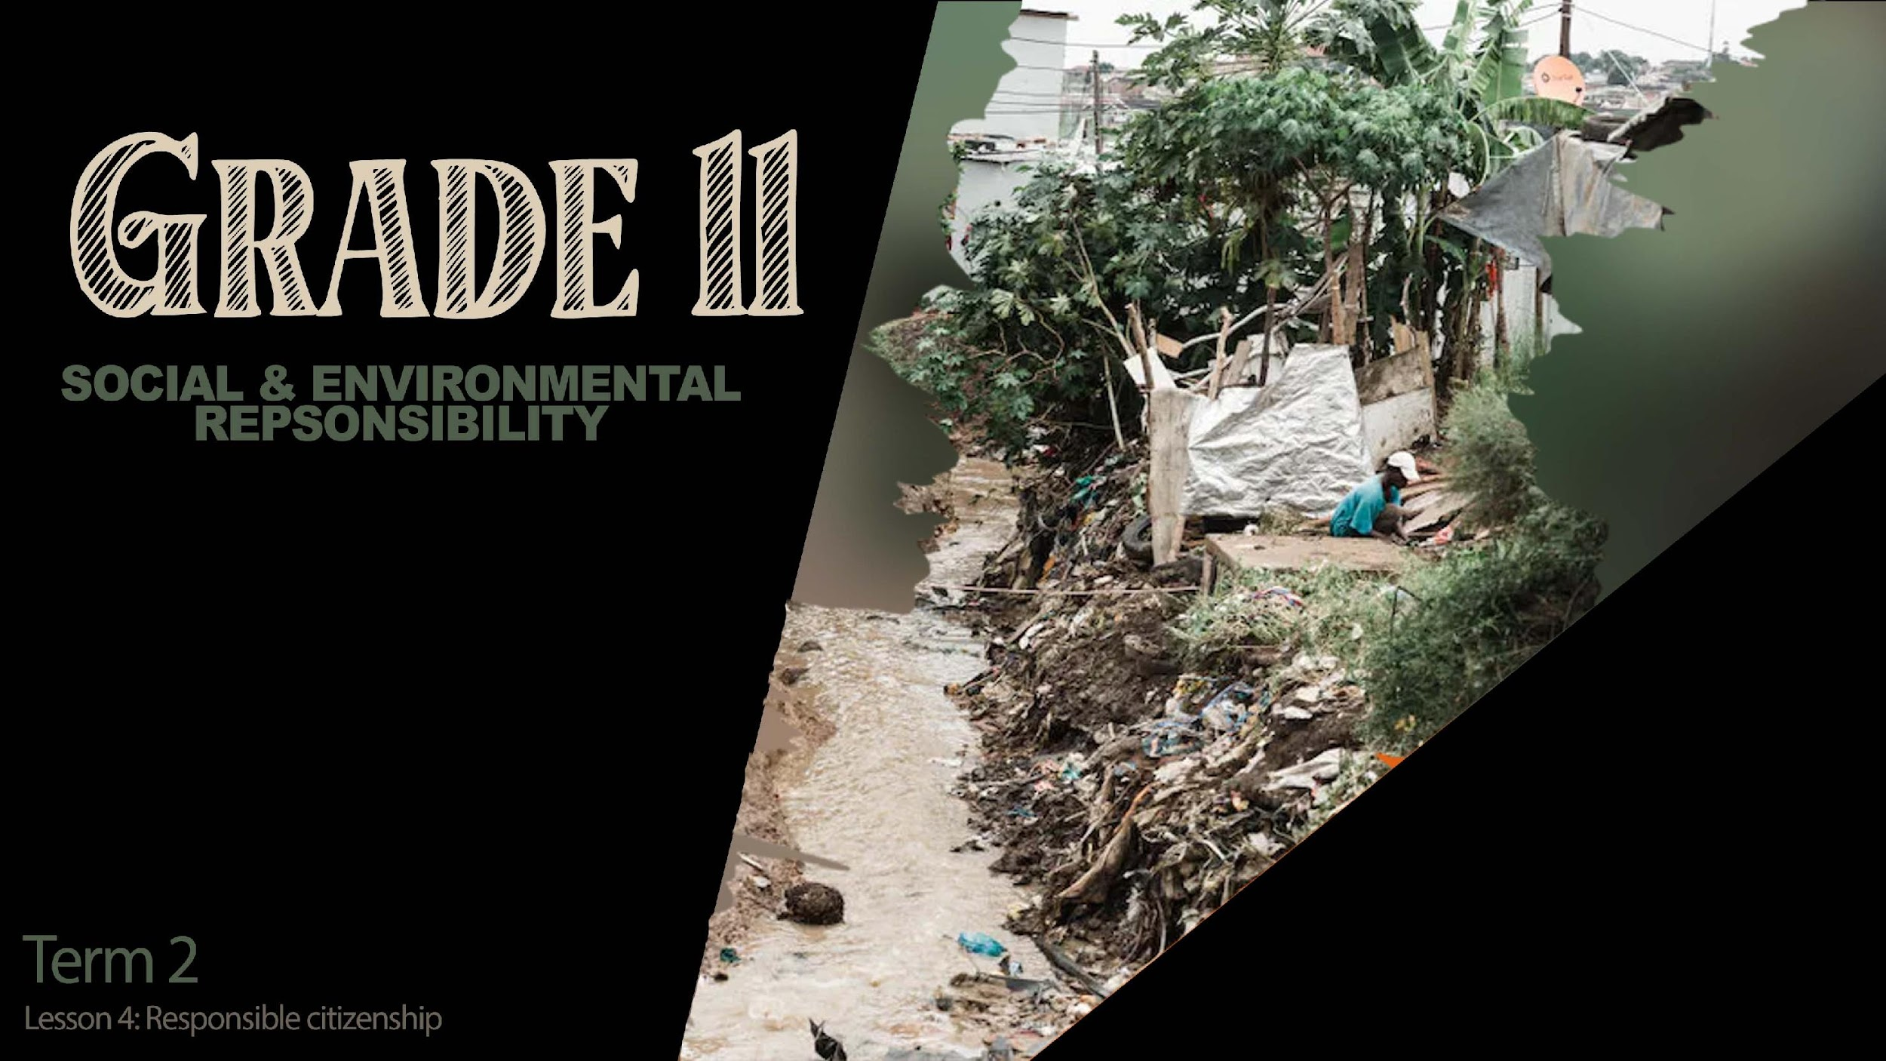

Notes:
Slide 1: intro 5
I’m sure you are all very excited to share your experiences from your journalism interview over the last week. I’m going to give you 5min to quickly organize your groups and to hand in your file that will be watched shorty. Remember each group will only have 4min for their presentation.
(Note to teacher- Usually there is a bit of wasted time opening files for learners to share. This lesson has left room for those possibilities. Should you finish watching the clips earlier, learners can start their homework activity in class. However, ensure that there is 3min for the reflection activity at the end of the lesson.)

Slide 2

Notes:
Slide 2: 23min approximately
It’s time for the news. We will now start watching the clips/ presentations from each group. After each presentation, I’m going to encourage the class to ask questions.

Slide 3
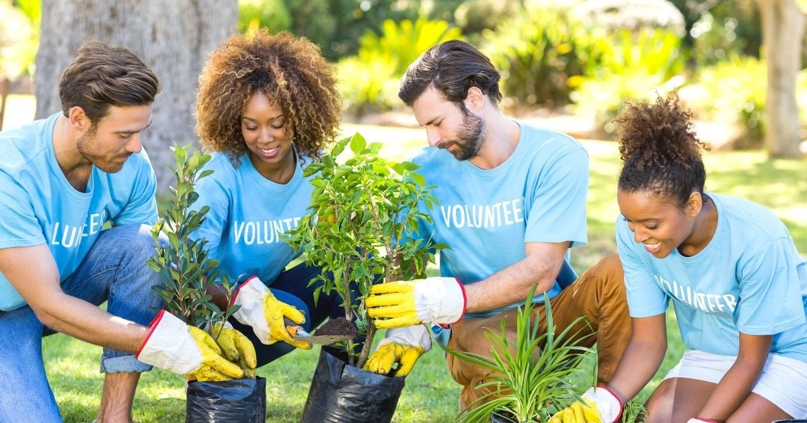
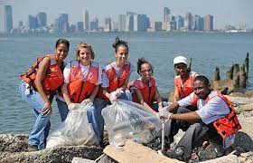
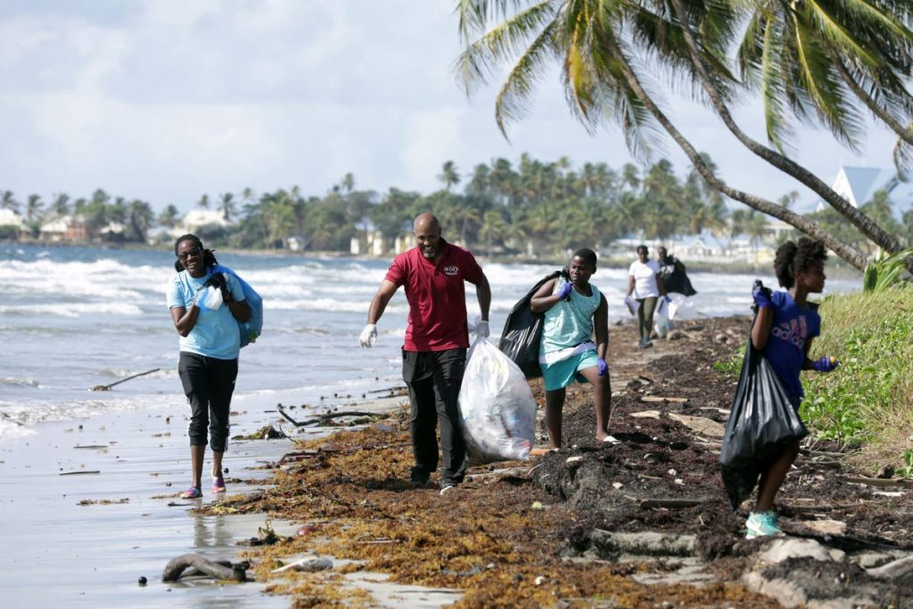
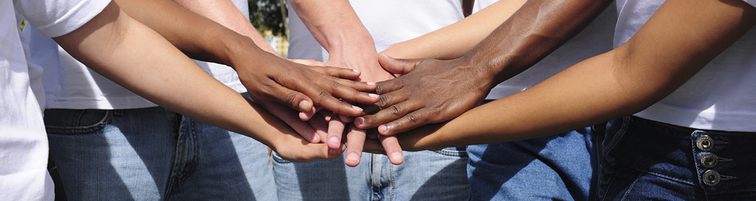
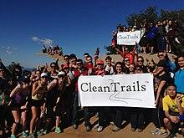
Make a difference!
Notes:
Slide 3: 5min
Thank you grade 11’s for such interesting research. Many of you made an effort in your presentations and this effort is greatly appreciated.
Let’s just briefly recap on community services that address these contemporary environmental issues. Some of you highlighted:
Pollution by dumping plastic and organisations that have gotten involved in educating the public on how to recycle. In some cases, the municipalities have arranged that recycling is collected from local communities.
Remember there are also communities like those who live in extreme poverty, that have limited resources of land as many people live in a small space. Many of these communities are the first to be severely impacted by rain or fire.
Here are a few other examples of how you could make a difference and ways to participate in a community service that address a contemporary environmental issue.
Start a campaign.
Volunteer at an organization, NPO or NGO
Start a recycling program at your school.
Educate your community on how to save water by making posters.
Get involved in a beach cleanup advertised on social media.
Create awareness about inhumane farming methods and the dangers of certain foods
You can now add possible community services that you can take part in (keeping your recent research and presentation in mind) – will create an opportunity for that at the end of Activity 2 (Lesson 4 – Worksheet).

Slide 4

Notes:
Slide 4: intro homework activity (3min at least)
You will have opportunity now to start Activity 1 (Lesson 4 – Worksheet) in class. These questions will show you how this section can be tested in a test or exam.
Hand out the Content Summary

Slide 5

Notes:
Slide 5: Reflection: 4min
Over the FOUR lessons, we have looked at environmental issues in your communities and globally and how they could impact your health.
On your worksheet on Activity 2, write a paragraph about the presentation today that most inspired you. List how it inspired you to participate in the community services . Include in your paragraph how this group activity has changed your opinion on climate change – and the role of mitigation and adaptation.
Furthermore, there is a list of practical ways to participate in a community service … select one.
(It might even help to play music. Tell the class to remain quiet until you say they can talk.)

