Slide 1
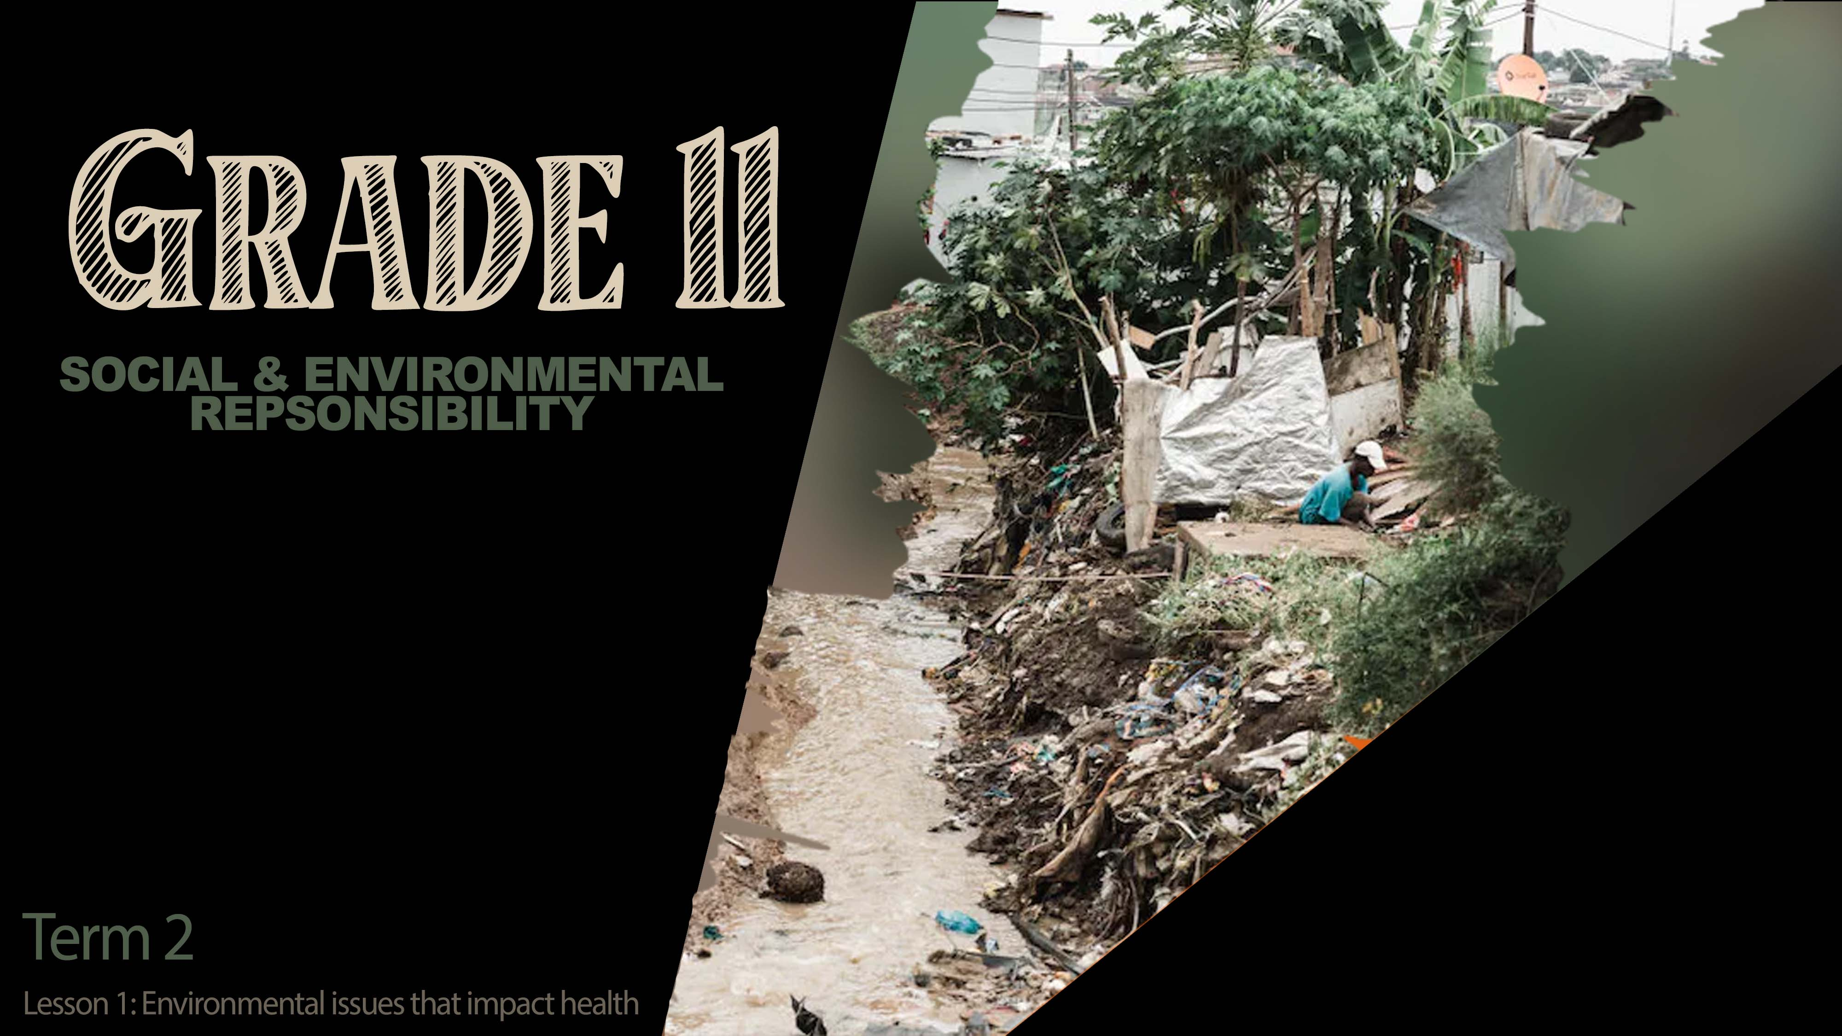

Notes:
Slide 1: 4 min intro
Welcome to this new series of lessons. In the previous lessons, we would have looked at the effects of unequal power relations on different people. You would have learnt about awareness campaigns to educate the public about different social issues and how to get involved and fight against these social issues.
Today we branch off looking at the effects that environmental issues have in South Africa. We know that environmental issues refer to the impact on natural resources because of the misuse or overuse by humans. Let’s take a moment to see if you can remember what the term ”environmental justice” means from Grade 10? (allow the class to respond.)
Well done! We could say that environmental justice refers to a person’s right to live in an area where they feel safe and they’re not impacted by things like flooding, no access to running water or electricity, or where there is a risk to their health.
Sometimes these environmental issues directly impact the health of the people that live in a community. Some of these environmental issues are obvious like flooding or pollution. Did you know that the way that animals are farmed for human consumption could also impact your health? With the large demand of meat for the increasing world population, many farming institutions use growth hormones or antibiotics to speed up the growth process of the animals. Some substances are put in food to make it last longer or look more appealing. Many of these substances could negatively impact your health.

Slide 2

Notes:
Slide 2 & 3: 4 min Individual Activity & Teaching 8 min
(Note to teacher: articles used for source for activity should any learners want evidence: https://www.health.com/condition/digestive-health/18-most-sickening-food-ingredients )
Most times we eat food not even knowing what is in it. We think that because it’s sold in a store, there can’t be anything bad for us in it. Sometimes these meats have been tested and still contain harmful substances as our laws do not find these substances as that harmful. Let’s see if you can can bust a few myths today? We’re going to look at a list of ingredients / substances found in different foods. You will be the mythbuster by determining if these ingredients / substances are truly found in these foods or is it a myth. Look at Activity 1 (Lesson 1 – Worksheet) (Allow 5min for the activity before discussing.)
It might come as a surprise to know that none of these items in this activity were a myth. How does that make you feel knowing that some of the food you eat may contain some of these substances?
Let’s look at a summary of this list again and see the impact this could have on your health.

Slide 3

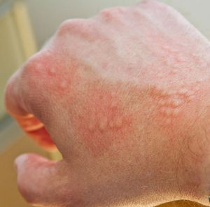


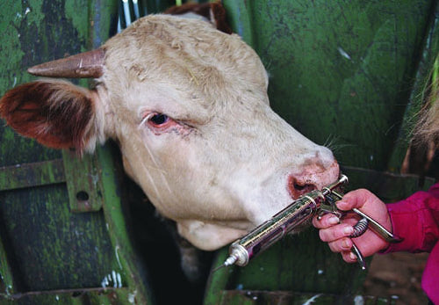
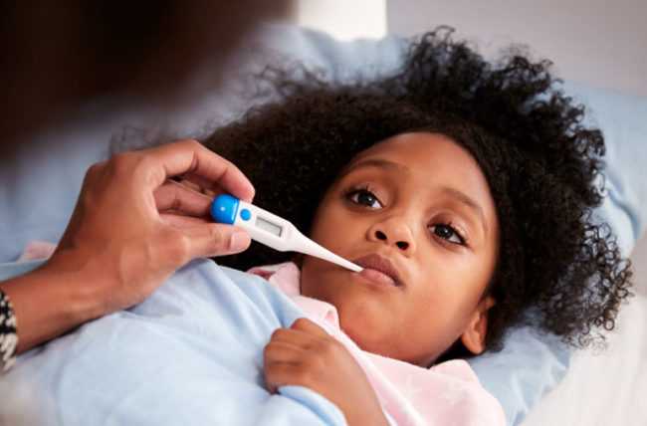

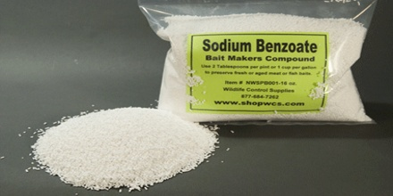

Notes:
Slide 3:
Some foods like meat/ milk contain antibiotics. These antibiotics were originally given to animals to prevent diseases. When we drink the milk or eat the meat, we could become immune to antibiotics. When we need to take antibiotics because we’re sick, it doesn’t work.
Some foods contain pesticides which were originally used to kill insects when growing crops. When humans ingest these vegetables, the pesticides are absorbed into the human body fat. Over time they have been know to make people ill.
Food additives like sodium benzoate often found in fizzy cooldrink to add colour and flavour. Humans respond in different ways to these substances. Some develop chest diseases like asthma and others, it impacts their ability to concentrate.
Many sweets that have a shinny surface have been coloured - which comes from insects like beetles or sprayed with shellac which comes from an insect like a cockroach. Humans could have allergic reactions to these insects, not to mention be severely “grossed out” by the thought of eating insects.
You will need to complete Activity 2 (Lesson 1 – Worksheet for homework. You’ll need to find three labels from three different products you enjoy eating. Read through the list of ingredients. Paste these labels in your notebook and indicate if any of these products contain the list of ingredients, we covered in the lesson so far.

Slide 4
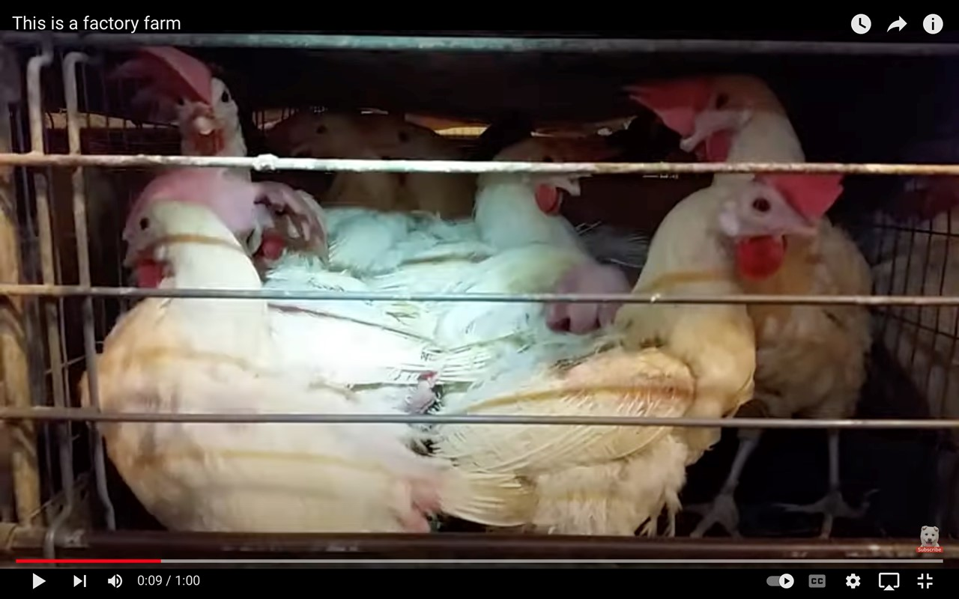
https://www.youtube.com/watch?v=BI1DX-UI1tg
Notes:
Slide 4 & 5: 1min watch & 8min discussion
Watch https://www.youtube.com/watch?v=BI1DX-UI1tg
Knowing that this process is so cruel, why do you think people still do factory farming?
Money! The more animals that can be produced to sell the more money these companies will make. In other countries, this type of farming is now illegal. But not in South Africa!

Slide 5
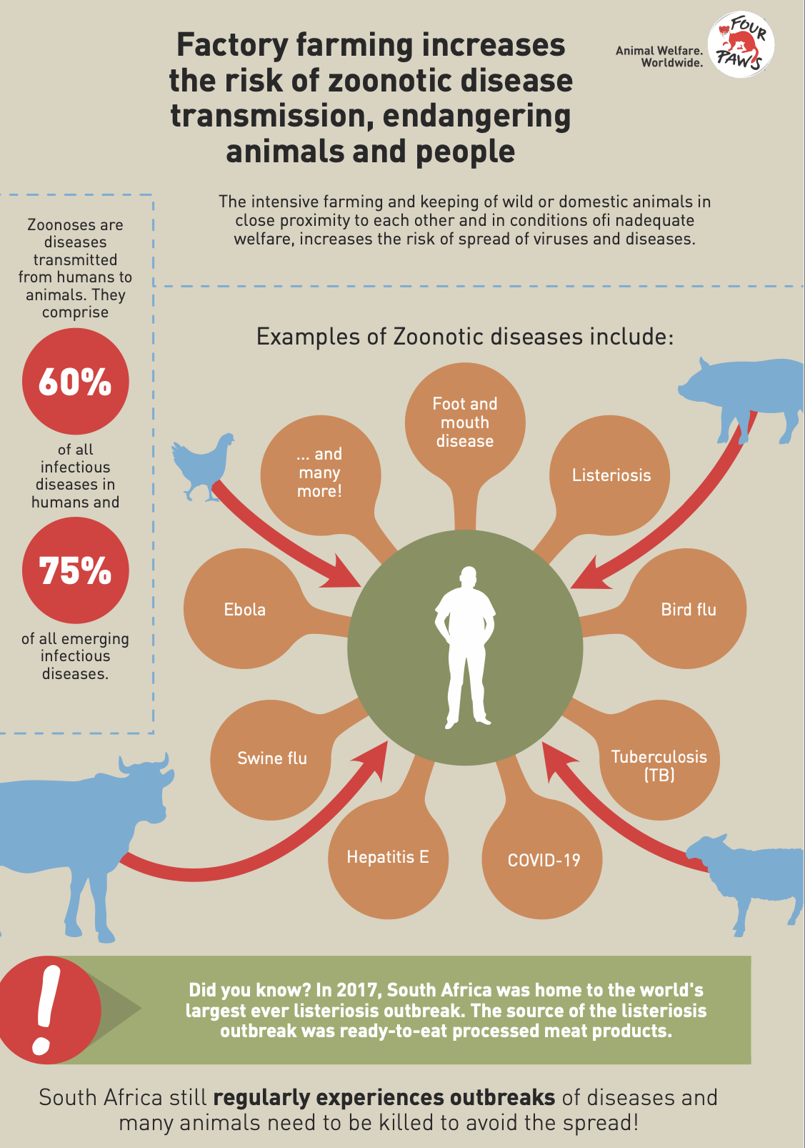
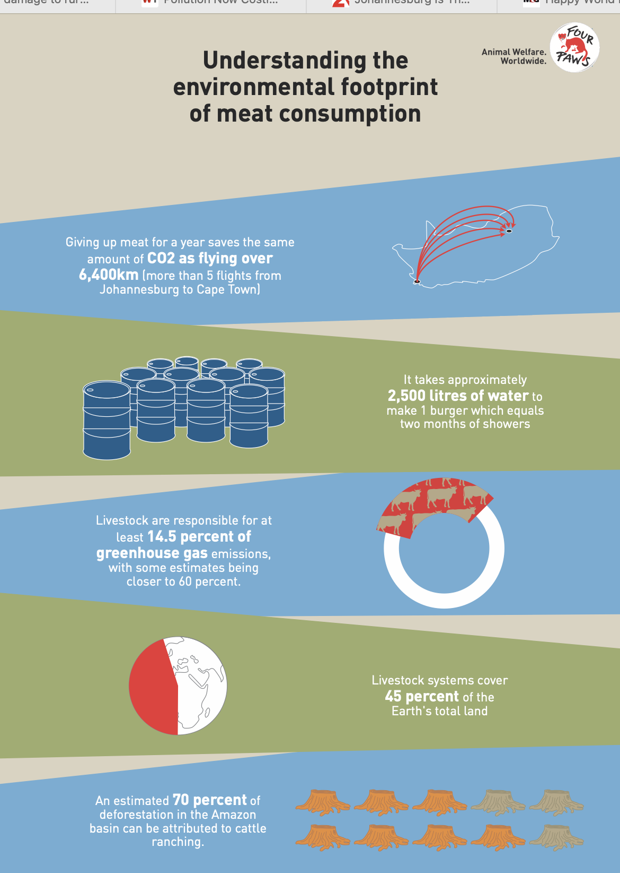
Notes:
Slide 5:
(Note to teacher: Allow each group 5min for discussion and use 3min for the groups to give feedback to the class.)
In your groups answer the questions on factory farming by referring to this slide and the questions in Activity 3 (Lesson 1 – Worksheet).
Discuss the impact on a local community being infected with one of these diseases indicated on the slide?
Explain how eating less meat could improve the welfare of animals.
In your group, discuss how you as a grade 11 learner could create awareness at school about factory farming.
It is unpleasant to realise that South Africa continues to allow such cruel methods of farming. We can take a stand, by educating our peers about these conditions and taking part in protests where we are aware that this kind of cruelty exists. Some of you might even encourage your parents to read the labels on food and rather buy free range meat. But remember there is also the reality that not everyone can afford to live on free-range chicken as its much more expensive than other food. The aim of this lesson is to educate you, so that you get to make your own choices.

Slide 6

Notes:
Slide 6: 12min ACTIVITY
Each group will get the same series of questions from Activity 4 but a different case study. Allow about 6min for the groups to discuss their findings and then allow each group 1min to give feedback to the class.
You will now have time to complete Activity 4 (Lesson 1 – Worksheet). Each group will receive a different article (Lesson 1 – Case Studies 1-5) to read and answer the questions from Activity 4. Choose a group leader to provide feedback to the class. Each group will be required to use the Lesson 1 - Poster template to create an infographic on their main environmental issue.
This poster must include:
An explanation of why this is an environment issue
How this issue causes ill heath for humans?
Examples of this environmental hazard in your local community?
THREE suggestions on how you as high school learners could prevent this environmental hazard from happening at your school.
Just to summarise, we have covered the following main environmental hazards in these case studies:
Soil erosion
Pollution
Floods
Fires
Radiation is also an environmental hazard. The most common form of radiation we are aware of is from the UV rays of the sun. Too much time exposed to the sun could result in a short-term sun burn or long term this could result in skin cancer.

Slide 7

REFLECTION
Notes:
Slide 7: 3min Reflection
As we finish off this lesson, read through and answer the questions on Activity 5 (Lesson 1 – Worksheet), as you reflect on the following:
Name ONE environmental issue from today’s lesson that you feel your school needs to educate their local community on.
What positive influence could you have on addressing this issue in your school.
What advice would you give the RCL to develop a culture of caring for the environment at your school?
Don’t forget to complete Activity 2 in Lesson 1 – Worksheet for homework.

