Slide 1
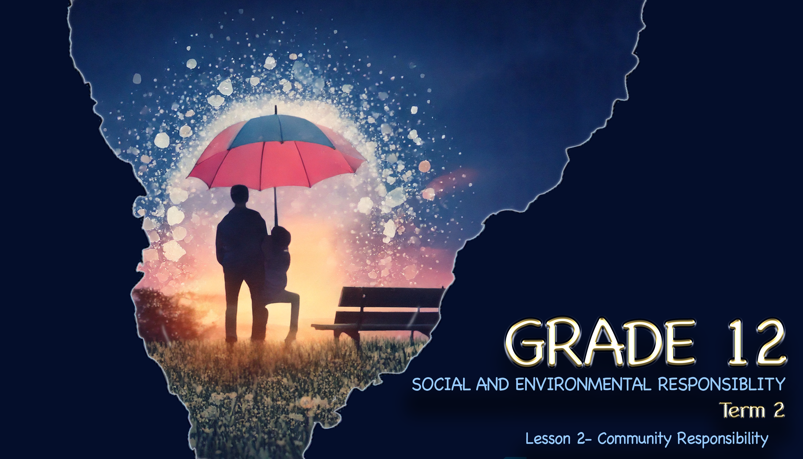

Notes:
Slide 1 & 2 Intro
Note to teacher: These lessons will often work with discussions with a partner. At times, learners will be required to work in groups of SIX. Most of the lesson alternates between short teaching moments and brief activities. Keep an eye on the time allocation for Activities 1-3 as they should be completed very quickly.
Good morning, Grade 12s! Today, we’re diving into a topic that’s close to home – literally. Let me start with a question: What does it mean to be part of a community? (Pause for brief responses.)
It’s about connection, support, and shared responsibility. That’s our focus today: The community’s role in creating environments and services that keep us safe and healthy.
Communities aren’t just buildings and roads; they’re made of people. And every person, including you, has a role in shaping spaces that promote well-being. But what does this responsibility look like?
It means advocating for clean water, safe parks, quality healthcare, and holding leaders accountable. It’s also about looking out for one another, like reporting hazards or starting local projects.

Slide 2


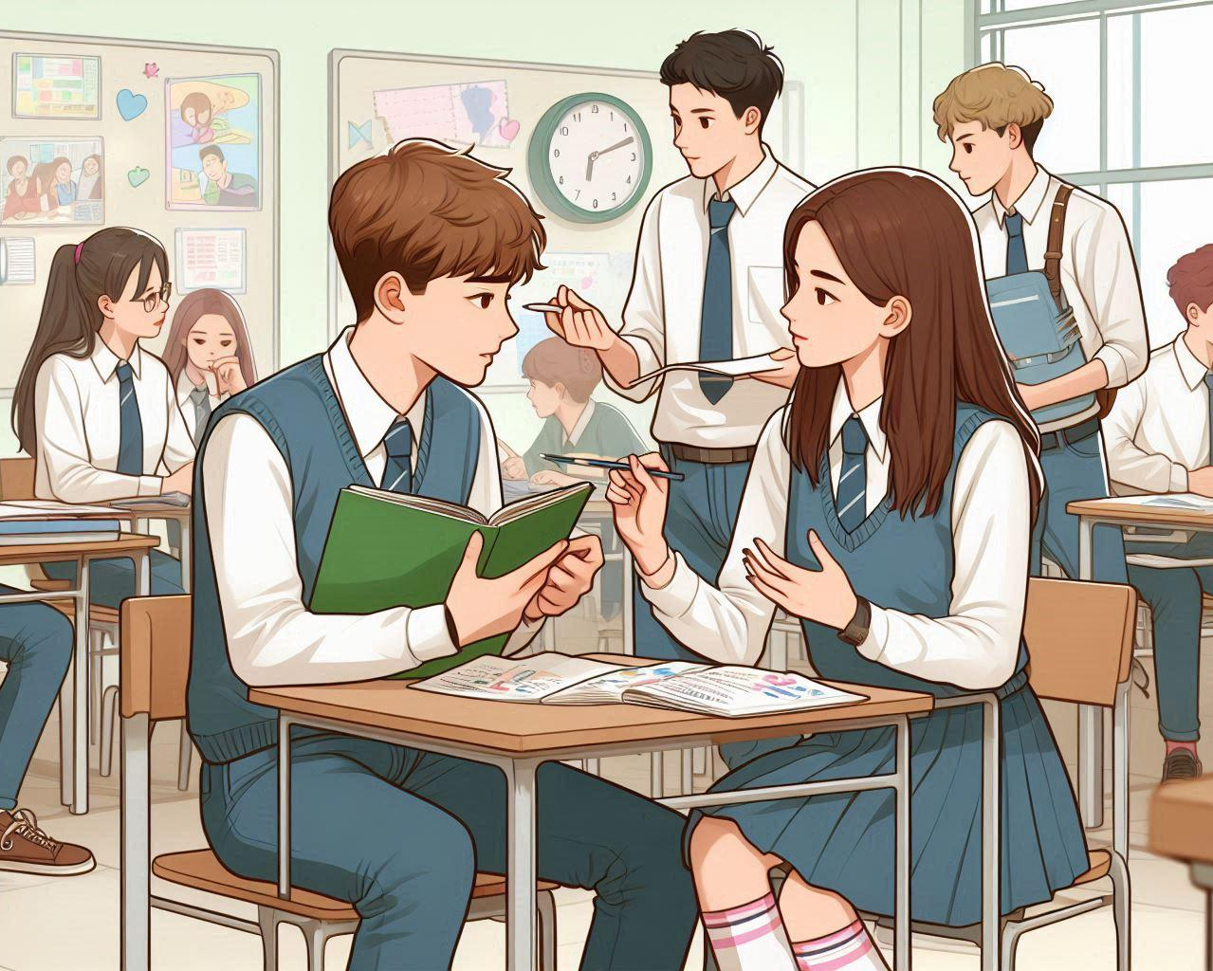

Issues?
Homework?
What issue did you want to fix and how would you do it?
Who could you ask to help with this issue?
Notes:
Slide 2: Icebreaker: Pairs 4 minutes
Remember last week in your reflection you were asked to “think” about an issue at school that you would like to see addressed. Write your response in Activity 1 (Lesson 1 – Worksheet) and then share with your partner what the issue was that you identified and how it could be solved. Don’t forget to share how you would fix this issue, and who you would ask for help in solving this issue.
It is challenging to fix most issues, particularly in a school environment. But, if you start to look for positive solutions to challenges, this will have a ripple effect in motivating others to become more responsible citizens.

Slide 3
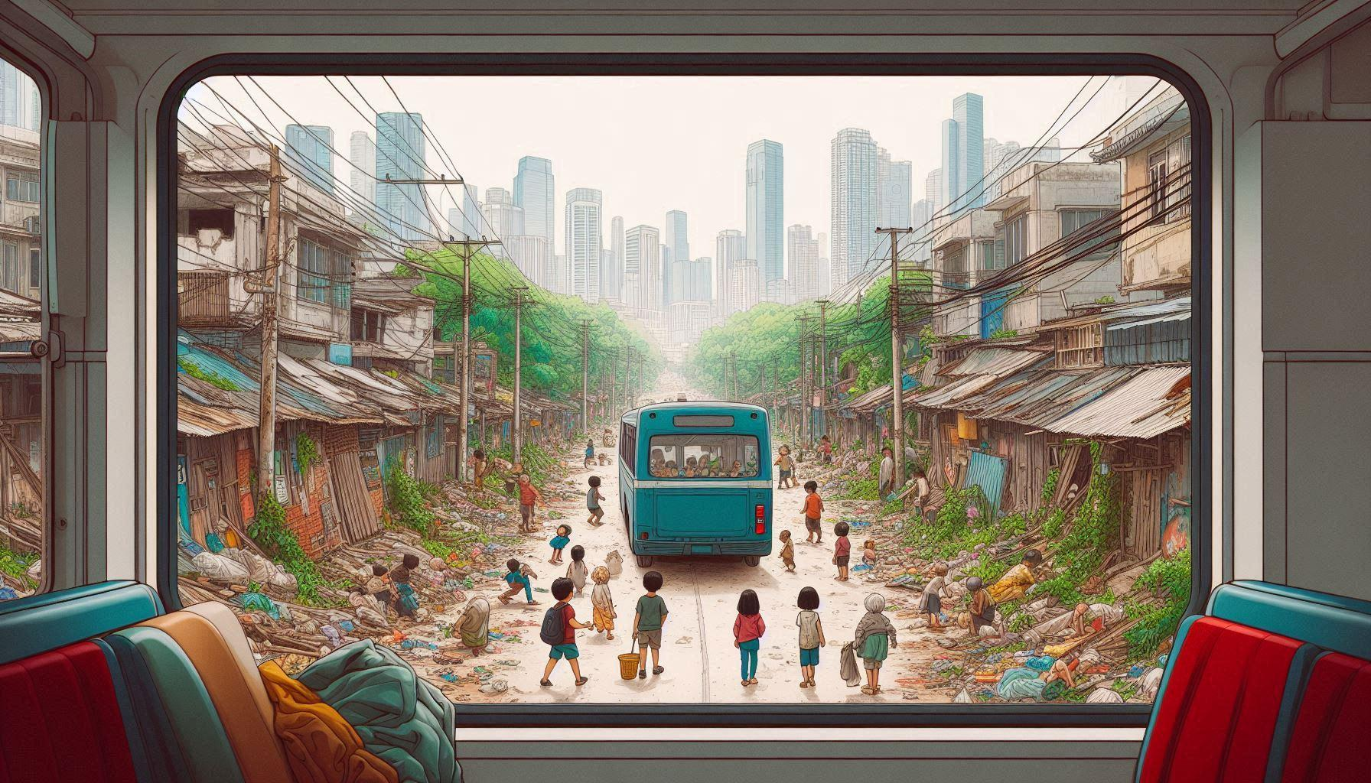
Look closely at the picture and identify as many issues as you can that need to be addressed.
Notes:
Slide 3: Pairs (1 minute, 1 minute feedback)
They say a picture is worth a thousand words. Look at this image with your partner. You will have only 1 minute to identify as many issues that need to be addressed. Quickly complete Activity 2 (Lesson 2 – Worksheet).
After a minute, take 1 minute to share with your partner what you identified.
Well done Grade 12’s. Maybe these were some of the issues you identified: Refer to Lesson 2 – Worksheet MEMO for answers.

Slide 4
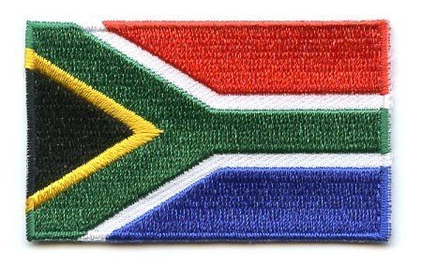

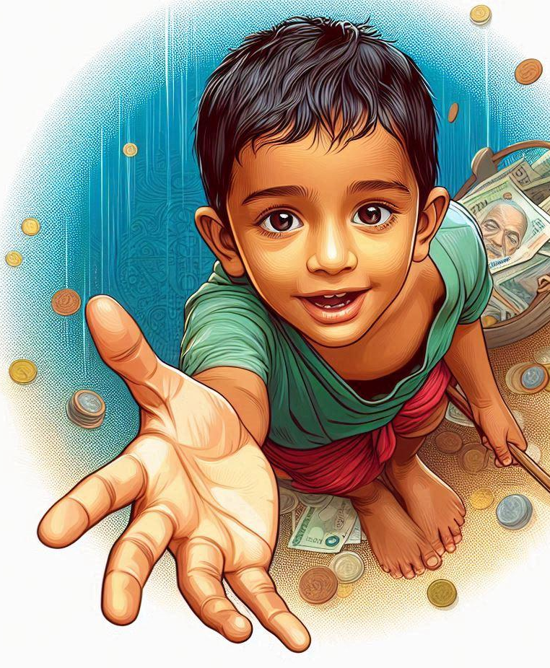

So, who is responsible?
The South African Constitution guarantees your right to a safe and healthy environment
This means we ALL share responsibility to protect our surroundings
Notes:
Slide 4-6: Teacher input (1 min)
Constitutional Rights: The South African Constitution guarantees every individual the right to a safe and healthy environment. This establishes a collective responsibility among community members to protect their surroundings and advocate for sustainable practices.
Because we live in a democratic society, we are expected to protect that democracy and those who live in it.

Slide 5
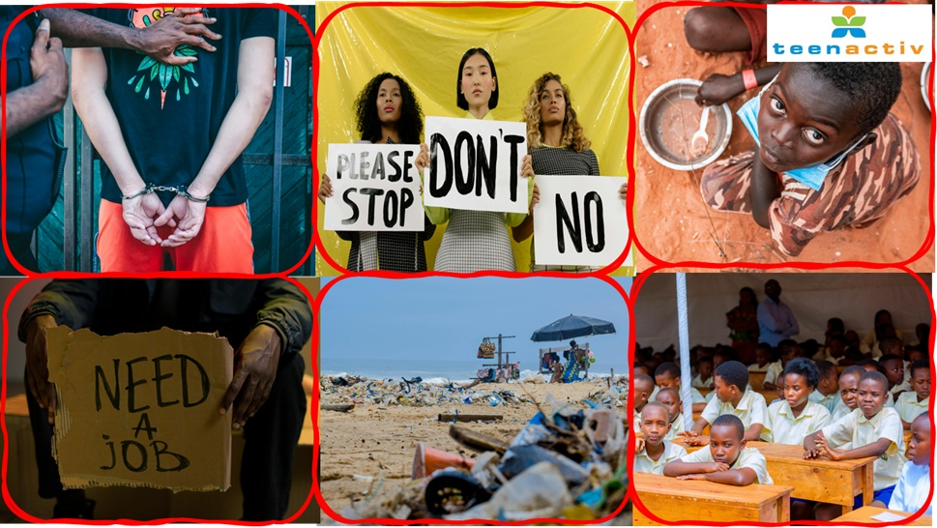
Notes:
Slide 5: Pair Activity (2 min)
Look at the images on this slide. In the corresponding block in Activity 3 (Lesson 2 – Worksheet), identify the issue that is plaguing many of our communities.
Note that many of these issues have been part of our social, political and economic landscape for a while, but they still need communities to work together to deal with these issues.
From the top row (left to right), did you identify:
Crime (high crime rate and violent crime)
Gender-based violence
Hunger and starvation, especially affecting children
From the bottom row (left to right), did you identify:
High unemployment, especially among the youth
Pollution (plastic waste and environmental damage)
Inequality in education (overcrowded classrooms and lack of resources)

Slide 6







Cleanup
Conservation programme
Education
Advocacy
Notes:
Slide 6|: Teacher Input (2 min)
Community responses to environmental challenges: Generally, community responses to social and environmental challenges fall into four basic categories:
Environmental cleanups are direct actions where community members gather to remove litter and pollutants from natural spaces. These hands-on activities not only improve local ecosystems but also build community bonds and environmental awareness.
Conservation programmes focus on protecting and restoring natural habitats and endangered species. These initiatives, often partnerships between communities and conservation organisations, create sustainable solutions for preserving biodiversity.
Education programmes empower communities through knowledge. By teaching sustainable practices in schools and community centres, these programmes help people understand environmental issues and equip them with skills to address challenges locally.
Finally, advocacy involves communities raising their voices to influence environmental policy. Through petitions, awareness campaigns, and engaging with local government, community advocacy drives systemic change beyond what individuals can achieve alone.
Remember, these responses are interconnected. A community cleanup might spark educational initiatives, which lead to conservation efforts, supported by advocacy for policy change. Together, they represent how empowered communities can transform environmental challenges into opportunities for positive change.

Slide 7
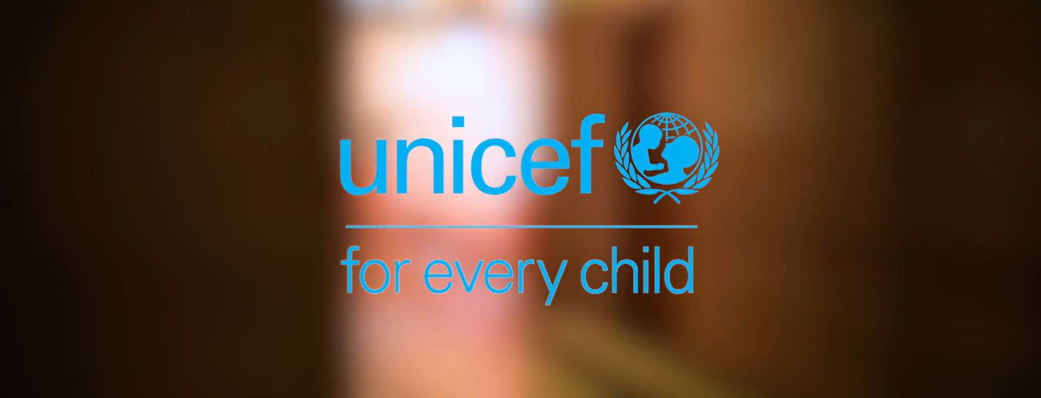
Watch: Youth advocacy trainings for nutrition and mental health in South Africa https://www.youtube.com/watch?v=LNwb_Wb_hG0&t=3s (4 min 17 sec)
Notes:
Video clip (4 min 17 sec) Question and feedback (6 min)
Watch: Youth advocacy trainings for nutrition and mental health in South Africa
https://www.youtube.com/watch?v=LNwb_Wb_hG0&t=3s (4 min 17 sec)
Learners to answer the questions in Activity 4 (Lesson 2 – Worksheet)
Refer to Lesson 2 – Worksheet MEMO for possible answers.

Slide 8
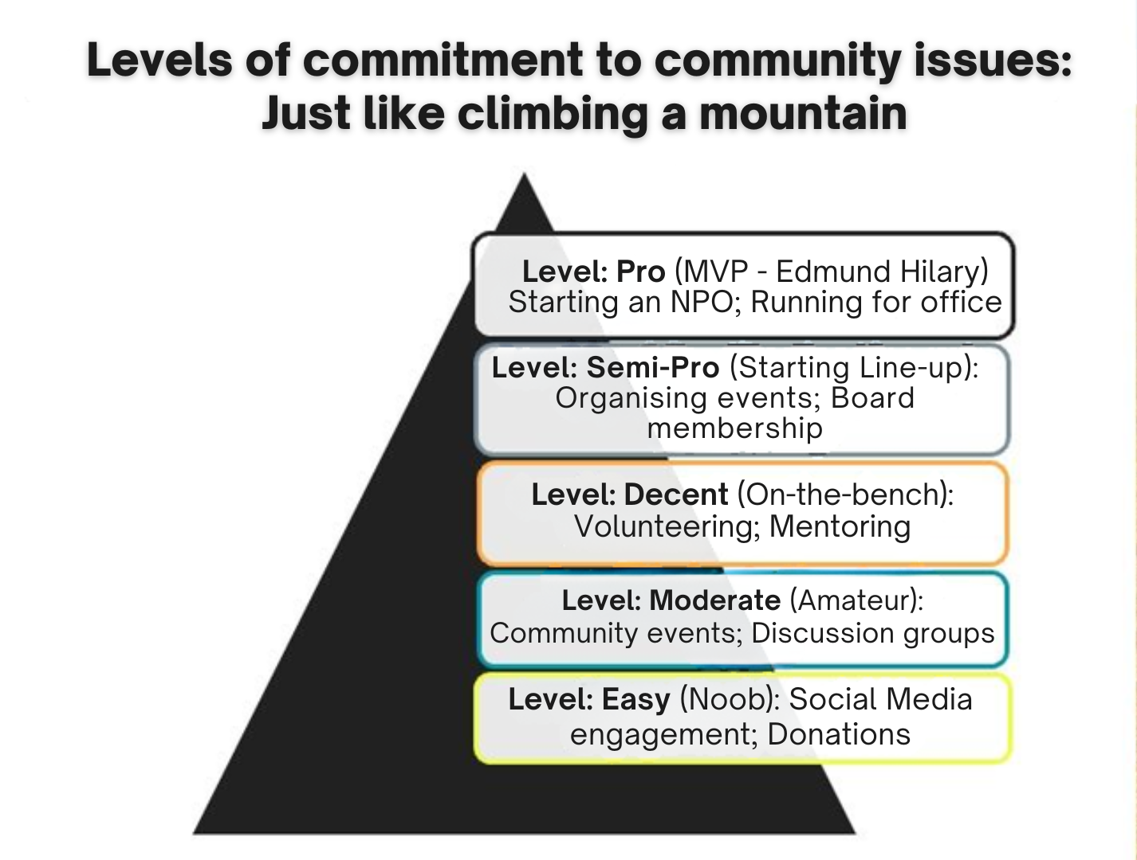
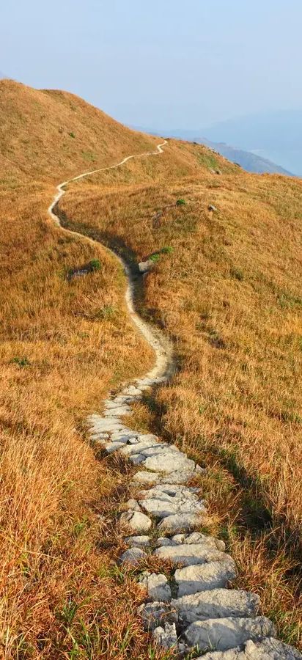
Notes:
Slide 8-9: Teacher Input: (3 min + 15 min)
Teacher Input: (3 Minutes) Getting involved in your community to make a difference in society is a selfless pursuit, but also one of the most rewarding things you can do.
There are different levels of involvement you might choose to follow, starting with low-level actions such as engaging on social media, like sharing posts that raise awareness for a cause or organisation.
As your involvement grows, the demands on your time, skills, and even your resources may increase. This will also depend on the need and the cause you are passionate about.
For example, an easy level of involvement might be sharing a social media page, while a semi-pro level could involve organising a fundraiser to clean up your school.
In South Africa, there are many deep and urgent needs, which means the demand for volunteers (people with a strong sense of conscience and boundless energy) is greater than ever. This brings us to one of the biggest causes in the country, a cause truly worth the sacrifice...

Slide 9

Watch: GBV Soundbite https://www.youtube.com/watch?v=Eij_CKn9kX4 (3 min 14 sec)
Notes:
Slide 9- Learner discussion and Feedback: Video (3 min 14 sec) Discussion (8 min); Feedback (3 min)
Watch: GBV Soundbite
https://www.youtube.com/watch?v=Eij_CKn9kX4 (3 min 14 sec)
Discussion (8 min)
In your worksheet, you’ll find a breakdown of the different levels of community involvement. You can use this as a guide.
Learners to complete Activity 5 (Lesson 2 – Worksheet)
Feedback (2 min)
Refer to Lesson 2 – Worksheet MEMO for possible responses.

Slide 10
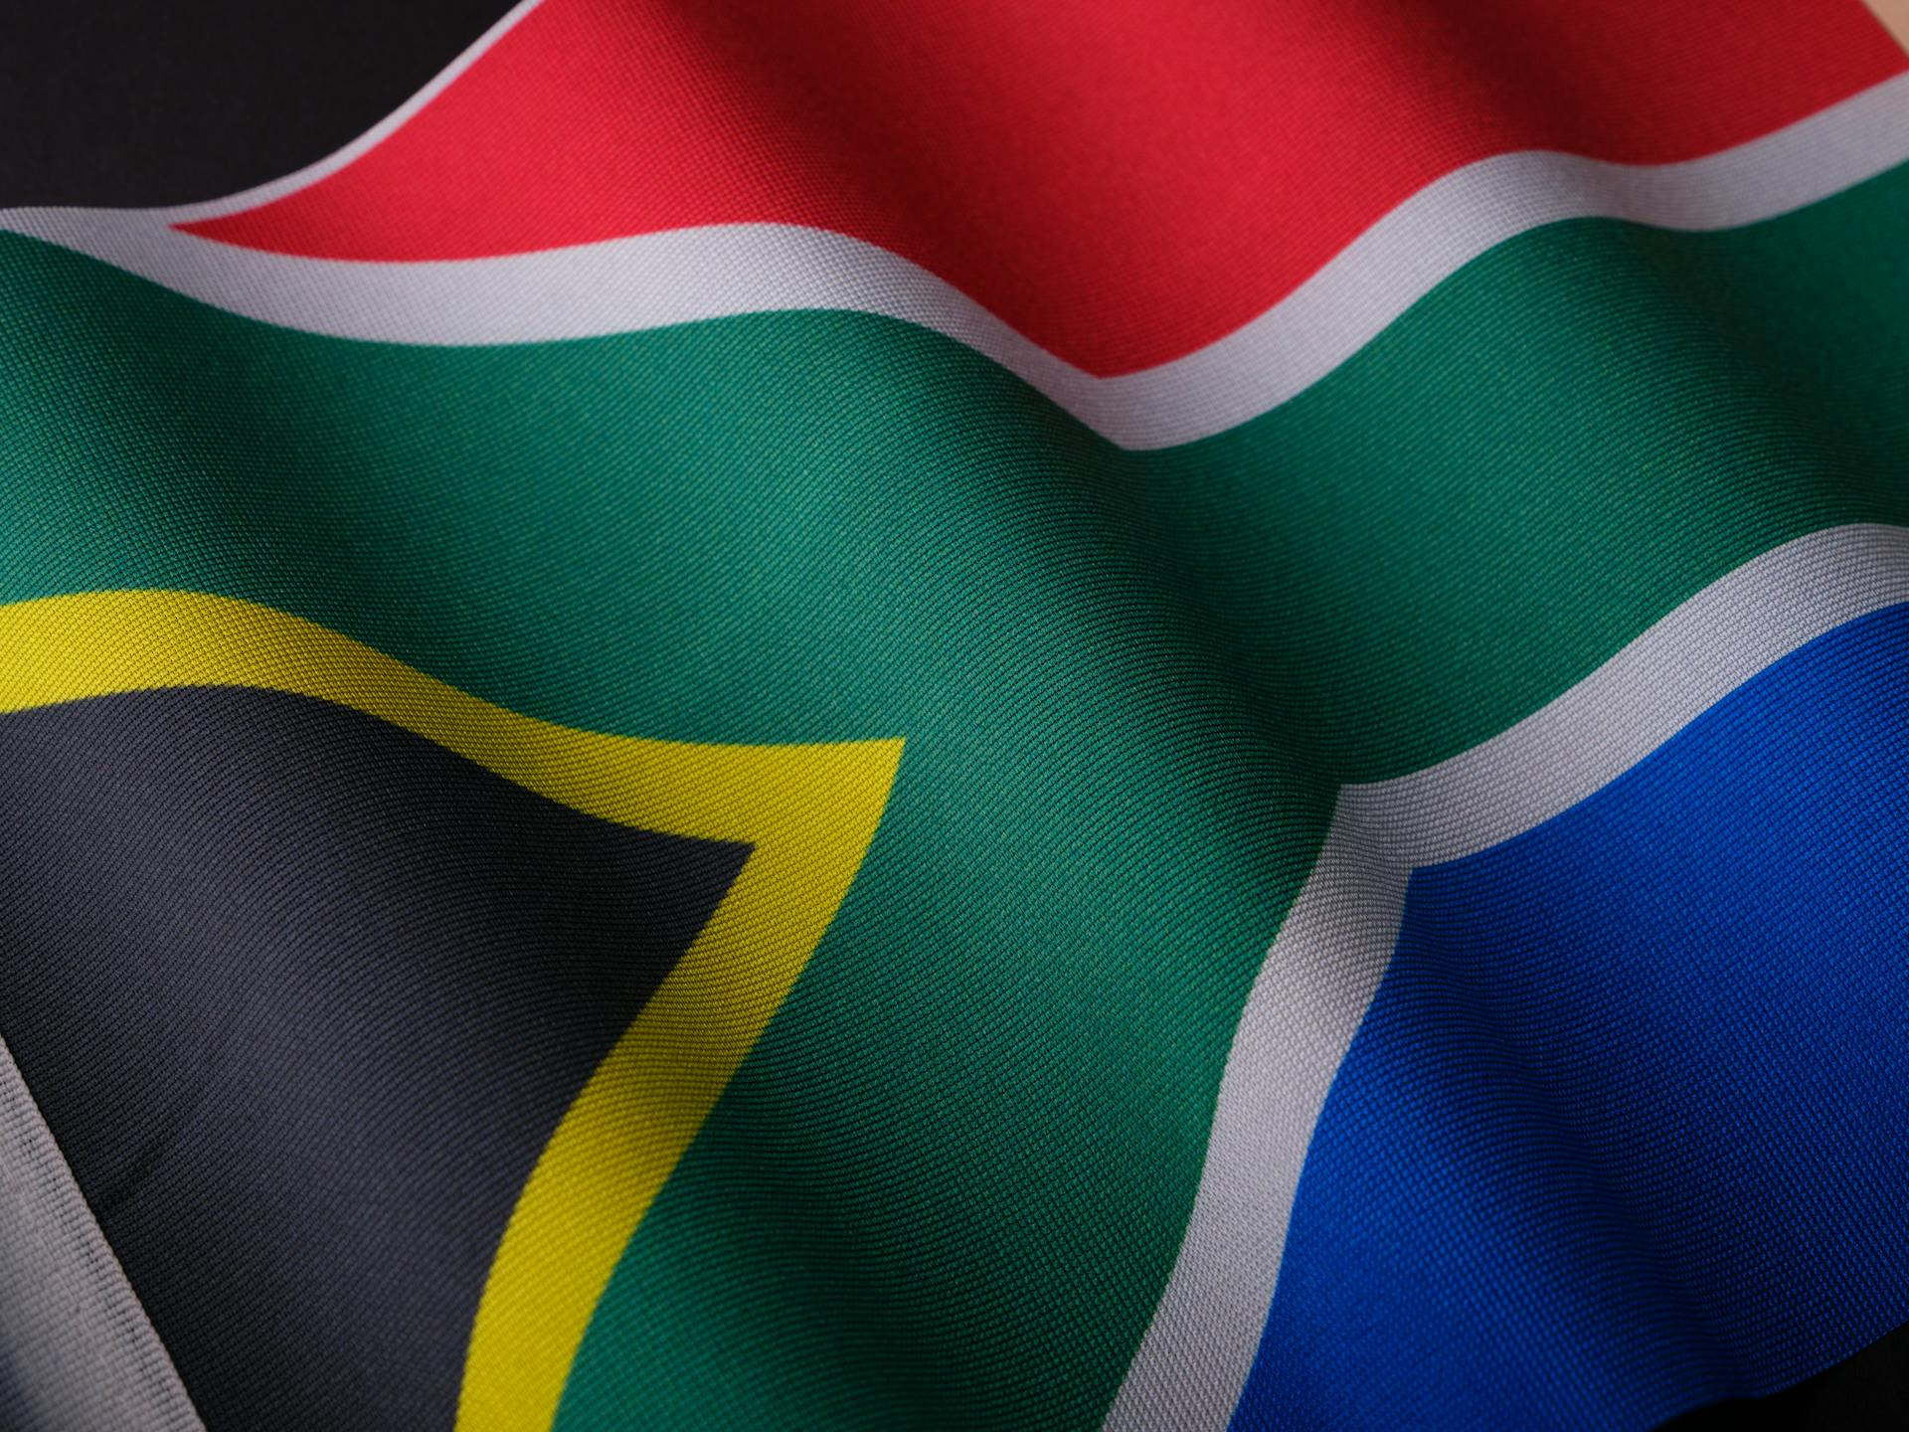





Reflection: Taking Responsibility Today
You have the power to create positive change.
Start with small actions in your community.
Work together for a safer, healthier South Africa.
Think of ONE action that you can do to help.
Notes:
Slide 10: Reflection (2 min)
As we come to the end of this lesson, look at the statements on this slide. Take a moment to think of your own local community group. Identify ONE action that you can take in your community to improve the quality of life or help others.
Learners to complete Activity 6 (Lesson 2 – Worksheet)
Remember, you have the power to make a positive change. Be part of the solution not the problem in South Africa.

