Slide 1


Notes:
Slide 1 & 2 Intro (5 min)
Note to teacher: For this lesson, learners should be seated in groups of four. They will begin by working in pairs for the first activity, but the group activity that follows will require groups of FOUR.
If there are not enough learners to form even groups of four, adjust as needed, but try to maintain the structure. This is important because, in the first part of the group activity, each learner will be assigned a letter: A, B, C, or D. After completing the initial task within their original group, all the A's will form a new group, all the B's will form another, and so on.
This regrouping allows each learner to present and give feedback based on a different case study, ensuring a rich exchange of ideas in the second part of the activity.

Slide 2

Notes:
Slide 2: Pair activity
Welcome back to lesson three in this series on social and environmental responsibility. I wonder how much you can remember from the last two lessons? Let’s play a memory game. It’s called “I say… you say”. You will need to choose one person to compete against.
Remember this is a memory game. So, start by taking one minute to write five concepts/themes/terms you remember from the last two lessons e.g. constitution.
Once your minute is up, one person will start and the aim is to see if you can get through your 5 words in 30 seconds.
One person says “I say “constitution”, you say…The other person needs to respond with a word that connects to the term you have spoken e.g. you say… “democracy”.
One person will try to cover all five words in 30 seconds. Then it's the other person's turn.
Right, I’m sure you’ve got it. Remember, you only have one minute to write your five words on your paper from memory. No looking in books! Let’s see who can get all five right.
Let’s start with today’s content.

Slide 3

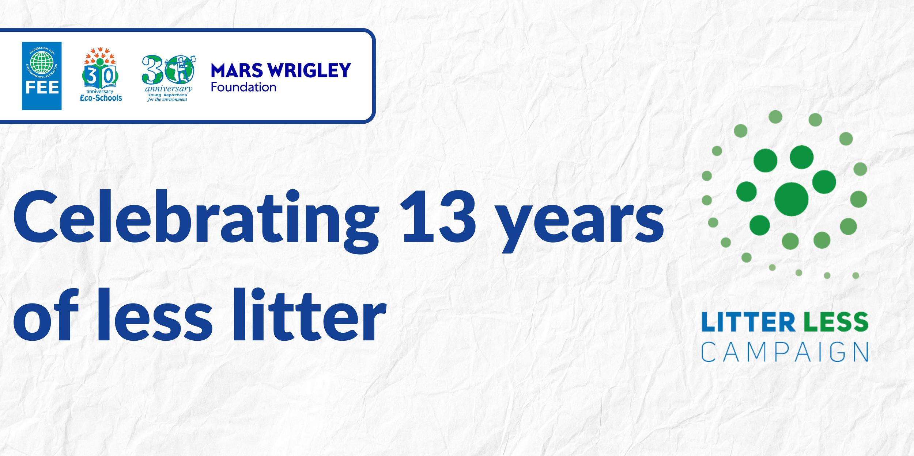
Identify and elaborate….
Understand how these programmes contribute..
Evaluate impact studies
Analyse the effectiveness
Notes:
Slide 3 -5: Teaching (3min) + (6 min) + (3 min)
By the end of the lesson today, you will need to be able to:
Identify and elaborate on educational and intervention programmes that focus on social and environmental responsibility. E.g. Environmental Awareness Campaigns: Programmes like Eco-Schools and Green Campus Initiatives teach learners and communities about sustainability, recycling, and climate change mitigation.
Evaluate impact studies related to projects that tackle social and environmental issues. Impact studies assess the effectiveness of intervention programmes. Evaluations typically consider:
Effectiveness and Outcomes: How well the programme met its objectives. E.g. Sustainability and long-term impact: Whether the intervention has long-lasting benefits.
The effectiveness of these programmes in promoting sustainable and healthy living.
In other words, our focus today is looking at different programmes and seeing how effectively they have created awareness, driven behavioural change, and implemented practical solutions to social and environmental concerns.

Slide 4
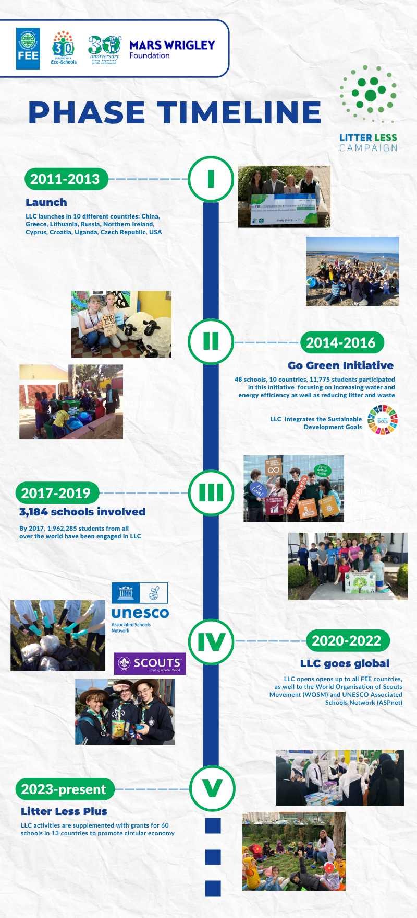
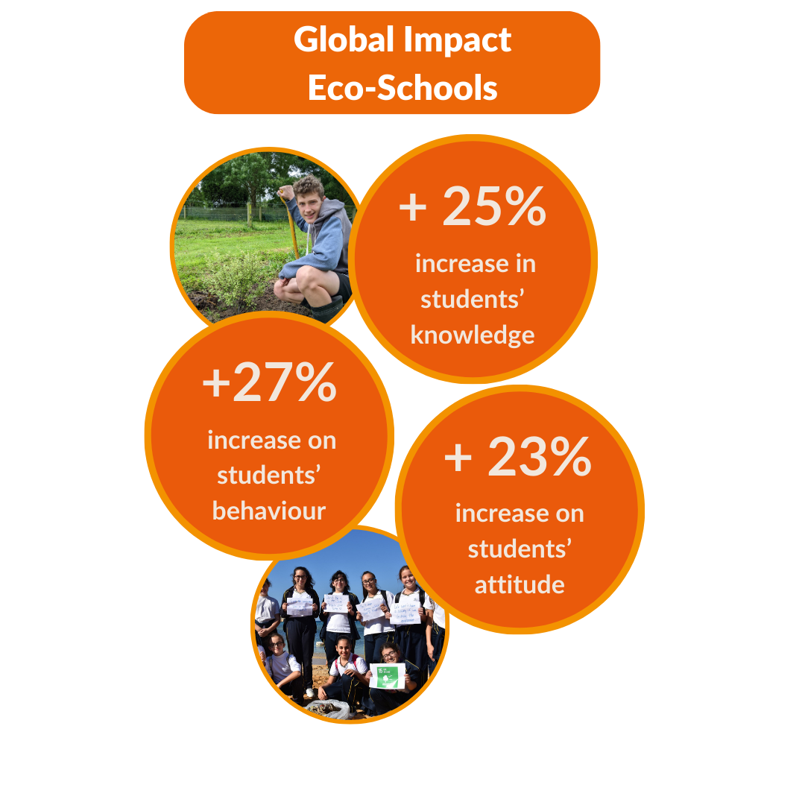
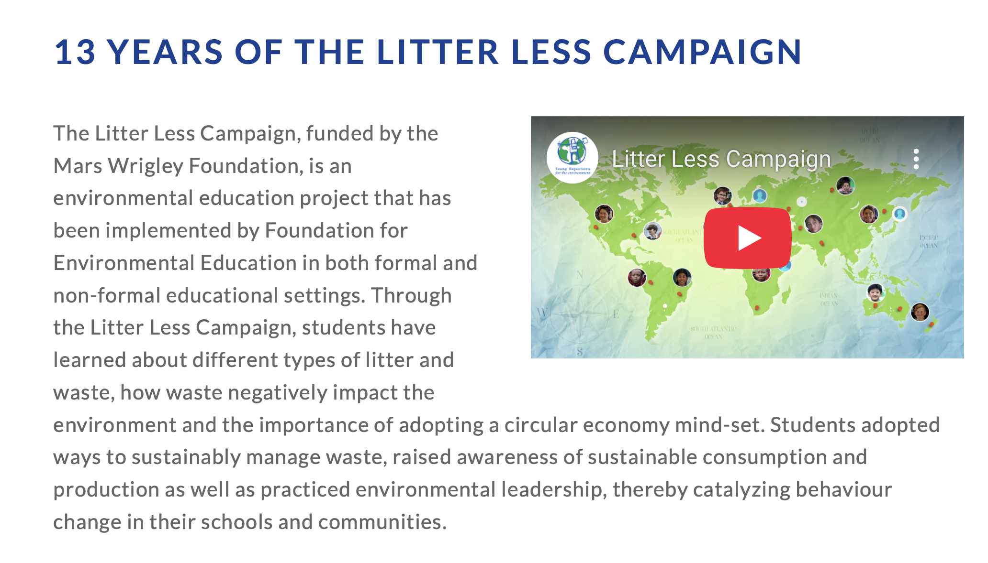

2. Understand
1. Identify
3. Evaluate
Notes:
Slide 3 & 4: Teaching & Pair Activity (6 min)
Complete Lesson 3_Activity 1 worksheet .) while working through this section.
Keeping in mind WHAT you need to be able to do, let’s look at this campaign as an example.
(Site is https://www.fee.global/litter-less-campaign-about)
Let’s start by watching this short video: https://www.youtube.com/watch?v=r7GhhgoJFRI&t=76s
Keeping in mind WHAT you need to be able to do, let’s look at this campaign as an example.
Read through the information on Slide 4. (Note to teacher: You may refer to this website for background knowledge: https://www.fee.global/litter-less-campaign-about)
Let’s start by watching this short video:
Watch: Litter Less Campaign
https://www.youtube.com/watch?v=r7GhhgoJFRI&t=76s (1 min 24 sec)
We will be completing Activity 1 (Lesson 3 – Worksheet) as we work through this section.
Learners to complete Q 1.1 to 1.4 in Activity 1 (Lesson 3 – Worksheet).
Possible answers are available in the Lesson 3 – Worksheet MEMO.

Slide 5
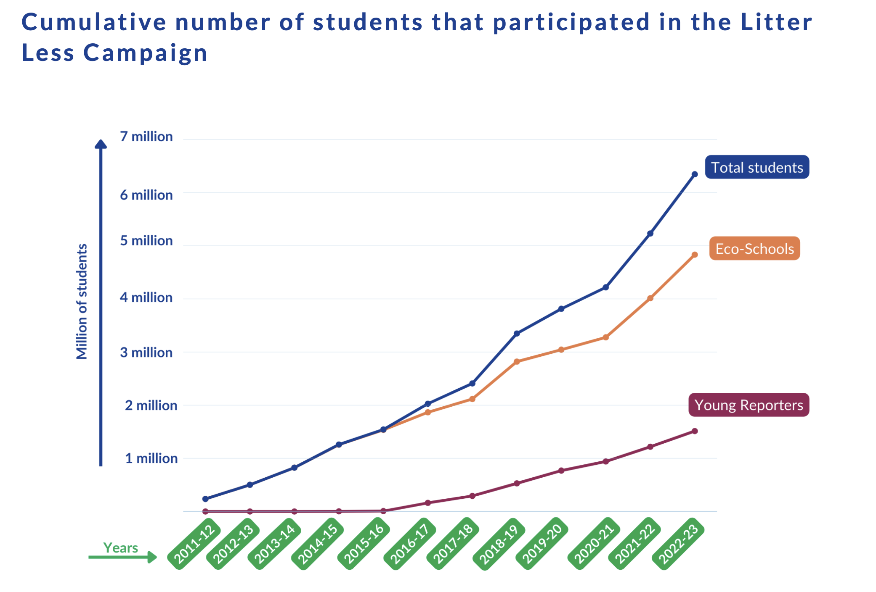
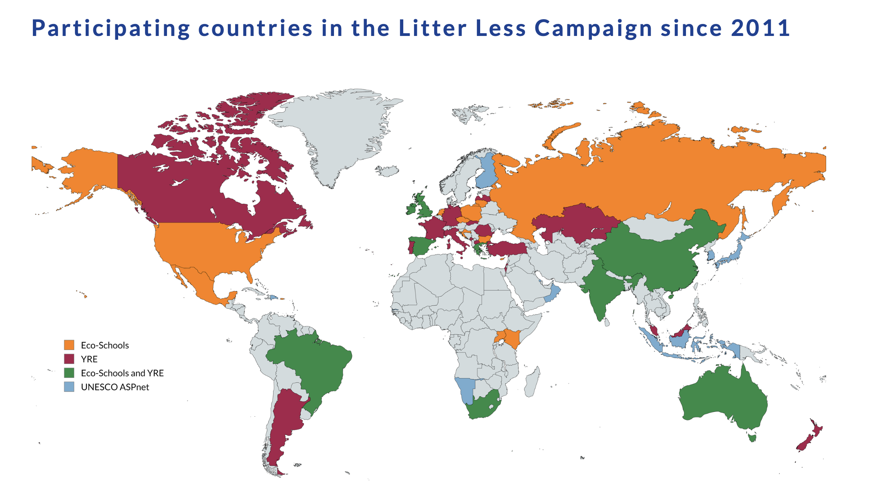

4. Analyse…
Notes:
It’s important that, as responsible citizens, we don’t support a campaign simply because it appears sustainable. We have a responsibility to critically analyse how effective the campaign actually was in promoting sustainability and healthy living.
Work through the information on Slide 5. (These images are also in the worksheet.)
Learners to complete Q 1.5 in Activity 1 (Lesson 3 – Worksheet). (Allow 2 min)
Possible answers are available in the Lesson 3 – Worksheet MEMO.

Slide 6

[Taken from: https://www.linkedin.com/pulse/how-standout-group-discussion-chhandos-pramanik/ Accessed: 19 March 2025]
Notes:
Slide 6: Group Activity (8 min)
We’re now moving on to a slightly different group activity.
First, within your group, label yourselves as A, B, C, and D. I will hand out a campaign case study to each group. There are FOUR different campaigns in total.
Hand out Lesson 3 – Activity 2 Case Studies.
As a group, discuss the case study and agree on your answers. Record your responses for Q 2.1.1 to 2.1.4 in Activity 2 (Lesson 3 – Worksheet).
Important: Each group member must take their own notes on their individual worksheet, as you’ll need them for the next activity.
You will have 8 minutes to discuss as a group and complete the activity.
Possible responses are available in the Lesson 3 – Activity 2 Case Studies MEMO.

Slide 7

[Image source and additional reading: https://civilian.com/a-complete-guide-to-campaign-measurement/ Accessed on: 19 March 2025]
Notes:
Slide 7- (8 min)
Part 2 of the Group Activity: Now it’s time to break up your current groups. Take your notes with you. All the A’s will form one group, all the B’s another, and so on for the C’s and D’s.
Each person will now have 1 minute to present the key findings from their original group discussion.
Total presentation time: 4 minutes
After all members have presented, work together in your new group to come up with FIVE questions (Q 2.2, Activity 2, Lesson 3 – Worksheet) that could be used to evaluate how effective these campaigns were.
Possible answers are available in the Lesson 3 – Worksheet MEMO.
Well done grade 12’s. I hope you found this activity thought-provoking.

Slide 8

Notes:
Slide 8: homework Assignment (5 min)
In the next lesson, we will spend a little time preparing you for your examinations later this term. Writing an LO examination is not just about memorising content. It’s about understanding what the question is asking and responding with a well-thought-out, application-based answer.
You will now have 5 minutes to read through the questions in your Activity 3 (Lesson 3 – Worksheet). This worksheet includes a sample question from each of the sections you will encounter in the exam paper.
Please complete it for homework, as it will help you get the most out of next week’s lesson.

Slide 9

Notes:
Slide 9: Reflection (2 min)
Often, it’s easy to reach the end of another LO lesson, close your books, and walk away without truly reflecting on the impact of what you’ve just learned. In these last few moments, consider the FOUR campaigns that were shared in Activity 2. If you had to come up with a campaign on an environmental or social issue that you feel strongly about, what would that issue be? Write this issue in Activity 4 (Lesson 3 – Worksheet).

