Slide 1


Notes:
Slide 1 & 2 Intro & Teaching (5 min)
Note to teacher: The first half of this lesson focuses on the mission statement, with a few active engagements to involve learners. The second part of the lesson guides learners on how to prepare for responding to examination scenarios. Many learners struggle in Life Orientation because they rely on memorising content without understanding how to apply what they’ve learned. This lesson aims to bridge that gap by emphasising practical, application-based thinking.
Good day Grade 12s. We’ve come to the end of this series of lessons. We’ve gone through a journey over the last few weeks looking at how local and municipal government can leave a positive mark on society. Perhaps these lessons have challenged you to think about getting involved, maybe even volunteering at an organisation in your community. You might be thinking, “I don’t have time, matric is so stressful. It would be impossible!”
We all reach points in our lives where we pause to re-evaluate where we are. We reflect on how we spend our time and often make changes that bring us closer to our goals. For example, maybe you’ve played club hockey every year since you were eight years old, but this year, you’ve decided to only play for your school so you can focus more on your studies.
We make these kinds of choices because we have dreams and a vision of where we want to go. How do you achieve your goals in the future?

Slide 2
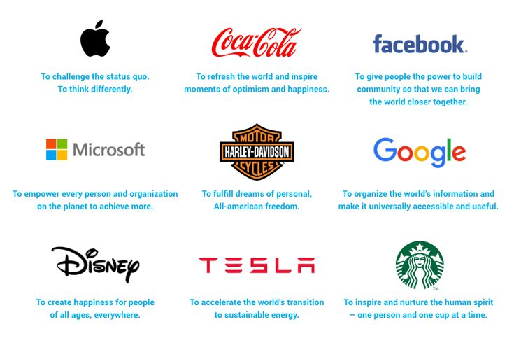
Notes:
Slide 2
For those of you who take Business Studies, you’ll know how important a mission statement is for a company. It provides direction and purpose, something that everyone in the organisation should know and work towards.
Let’s take a quick look at a few well-known brands on the Slide 2. Based on your own experience, do you think they’ve achieved their mission statement?
Turn to a peer and take 30 seconds each to share how one of these companies has fulfilled its mission in your life.
As you can see, some of these companies have excelled in fulfilling their mission statement. But every mission statement begins with a vision and a plan. In the same way, if you want to move forward in your own life, you need both a clear vision and a practical plan.
In this lesson we will look at how to formulate a personal mission and vision statement for your life.
To help you remember the process, we’ll break it down into THREE simple parts.
PART 1: CORE VALUES: Personal views, values, belief systems, religion, and ideologies.
PART 2: LIFE PURPOSE: Lifestyle (physical and emotional well-being) and goals for studies and career choices.
PART 3: FUTURE DIRECTION: Impact of vision on own actions/behaviour in life and environmental responsibility.
Keep in mind through this whole process that the VISION STATEMENT is the big picture you’re aiming for, whereas the PERSONAL MISSION STATEMENT is HOW you’re going to achieve that vision. It is a statement that helps you define your core values, life purpose, and the direction you want to take. It acts as a guide for making decisions and setting goals.
Let’s get started.
(Note to teacher: The next three slides correspond with Activity 1 (Lesson 4 – Worksheet) and provide step-by-step guidance for learners as they begin formulating their personal mission statements. Allow 3 minutes per slide for learners to reflect and write, using both the prompts on the slides and the guidelines provided in Activity 1.)

Slide 3
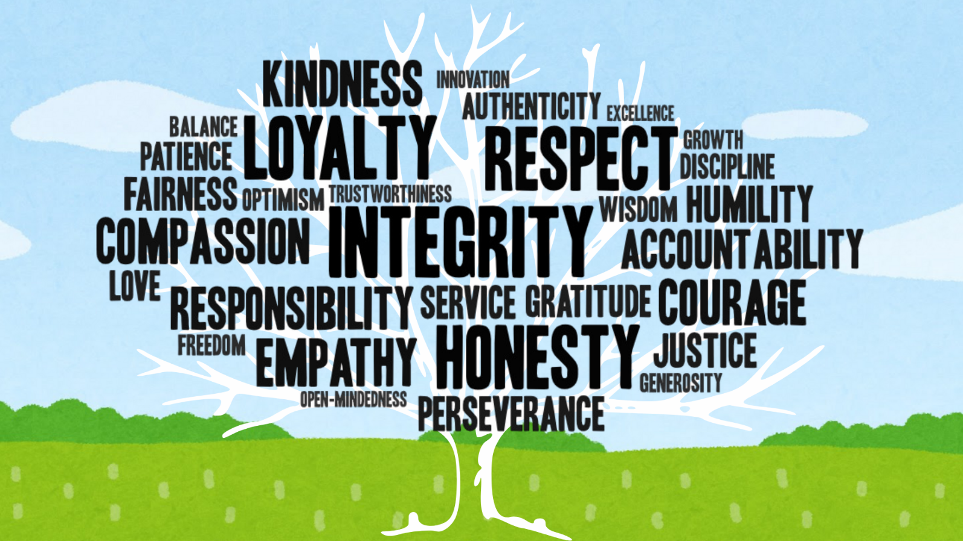
Notes:
Slide 3 - Allow 10 min
Let’s get started with PART 1: CORE VALUES: Personal views, values, belief systems, religion, and ideologies.
Start by reflecting on what your values are important to you.
Next, consider your personal views. This is your own personal responses and opinions on your future, religion, culture and values.
To write your personal mission statement, you need to reflect deeply on your values, priorities, and beliefs. It’s about aligning your actions with what truly matters to you, rather than simply going through life without direction. A personal mission helps you take control and lead your life with purpose. This requires knowing what you believe in and identifying the ideology or belief system you think both you and society should strive to live by.
When you want to start writing a personal mission statement, you need to reflect on what is important to you now and the kind of person you want to become in the future.
Learners to complete Activity 1 and Activity 2 (Lesson 4 – Worksheet).

Slide 4
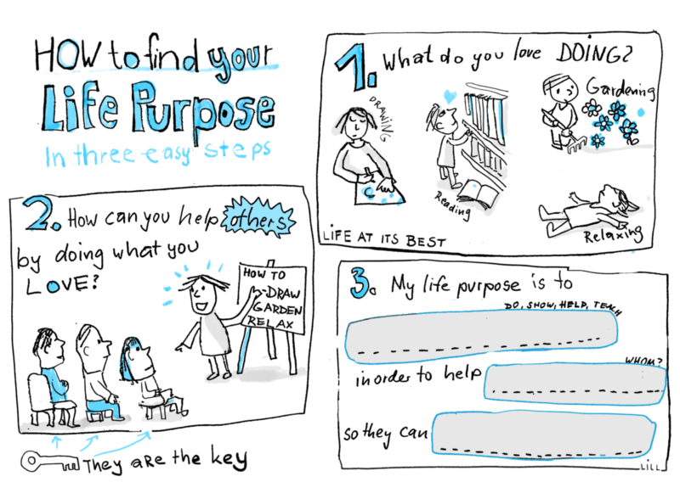
Notes:
Slide 4: 5 min
PART 2: LIFE PURPOSE: Lifestyle (physical and emotional well-being) and goals for studies and career choices.
Your lifestyle is the way you live right now, for example, how much you exercise, eat healthily, sleep, and take care of yourself. Remember, your mission statement is about your goals, so it can include what you would like to achieve in the future. This could also include goals related to your emotional well-being or personal dreams, like starting a family or getting married one day.
We have seen over the last few lessons how important it is to be environmentally responsible. Consider how you intend to live more sustainably.
Lastly, what are your goals for your career choices and studies in the years to come? PART 3: FUTURE DIRECTION: Impact of vision on own actions/behaviour in life and environmental responsibility.
Consider how your personal vision influences your actions, both now and in the future. Reflect on how it shapes your behaviour, your attitude towards others, and your sense of responsibility toward the environment.
Learners to complete Activity 3 (Lesson 4 – Worksheet).

Slide 5

HOW to ANSWER
LO
Questions
Notes:
Slide 5-9: 17 min Teach and Reflect on Activity
Note to teacher: At this point, hand out copies of Lesson 3 – Worksheet MEMO to the learners. They will need the memo response section to complete the upcoming activity. The next few slides contain animations to support the teaching of this section. Follow the prompts marked “click” to guide the flow of the lesson.
You were asked to complete a homework question in preparation for today’s lesson. As we go through the answers now, the focus is not on how many you got right or wrong, what really matters is how much you learn from the LO assessment techniques we discuss. The goal is to help you feel more confident and better prepared when approaching future examinations.

Slide 6
2.1 | Define the term ‘human rights violations’ and mention TWO ways in which courts can help protect citizens from human rights violations. | (1 + 2) (3) (DHR – Lower Order)
2.2 | Provide THREE responsibilities that should be upheld by the municipal government. | (3 x 1) (3) (SER – Lower Order)
2.3 | Describe FOUR forms of corruption which may have been experienced by legal officials. | (4 x 2) (8) (CCC – Middle Order)
2.4 | Suggest THREE methods legal officials could use to diffuse possible conflict situations between themselves and citizens making use of the court system. | (3 x 2) (6) (DSS – Higher Order)
1) Know the Curriculum
Notes:
Slide 6:
Let’s take a look at the question you were given for Section B.
How many of you read through it and thought, “I’ve never seen this before” or “We didn’t cover this in any of our lessons”?
This is a common reaction during exams. Often, learners struggle to make the connection between what they’ve studied and what the question is actually asking.
CLICK
Firstly, it’s important to know your curriculum.
The abbreviations refer to the main themes you’ve covered in Life Orientation each term:
DSS – Development of the Self in Society
SER – Social and Environmental Responsibility
CCC – Careers and Career Choices
In your exam, a single question may integrate content from two or more of these sections, so it’s important to understand how they connect.

Slide 7
2.1 | Define the term ‘human rights violations’ and mention TWO ways in which courts can help protect citizens from human rights violations. | (1 + 2) (3) (DHR – Lower Order)
2.2 | Provide THREE responsibilities that should be upheld by the municipal government. | (3 x 1) (3) (SER – Lower Order)
2.3 | Describe FOUR forms of corruption which may have been experienced by legal officials. | (4 x 2) (8) (CCC – Middle Order)
2.4 | Suggest THREE methods legal officials could use to diffuse possible conflict situations between themselves and citizens making use of the court system. | (3 x 2) (6) (DSS – Higher Order)
2) Read for understanding
Notes:
Slide 7:
Secondly, read all questions carefully before assuming you know the answer.
Take your time to highlight the key content words. These show you exactly what the question is asking. For example, in Question 2.4, the focus is specifically on legal officials and a conflict situation involving citizens using the court system.
Once you’ve identified the key content, you also need to understand what action is required. For instance, Question 2.1 says “define”, which means you’re expected to give a clear, factual statement.

Slide 8
(1 + 2) (3) (DHR – Lower Order)
(3 x 1) (3) (SER – Lower Order)
(4 x 2) (8) (CCC – Middle Order)
(3 x 2) (6) (DSS – Higher Order)
Definition/statement
Statement and qualifier/explanation
Statement and qualifier/explanation
If (3x3) marks, add an outcome
3) Mark allocation is a guide
Notes:
Slide 9:
Lastly, pay close attention to the mark allocation for each question. It guides you on how to structure your response.
When the mark allocation is (3 x 1), it requires three separate statements, each worth 1 mark.
A middle-order question might be shown as (4 x 2). This means you need to give four statements, each supported by a brief explanation or qualifier.
For higher-order questions, you may see allocations like (3 x 2), but more commonly (3 x 3) or (3 x 4). In these cases:
(3 x 3) typically requires a statement, a qualifier, and an outcome.
(3 x 4) may require a statement, elaboration on the statement, a qualifier, and an outcome.
Important: Even if your exact answer does not appear in the marking guideline, you can still be awarded marks, as long as the marker or moderator can clearly link your response to the marking guideline, and it meets the specific requirements of the question while including valid examples or explanations.
To become more familiar with the types of questions and how to respond accurately, it’s important to practise using past NSC exam papers along with the marking guidelines. This will help you understand the question format and what is expected in your answers.
Now that we’ve worked through these factors, use the Lesson 3 – Worksheet MEMO and begin marking the answers you completed for homework. Use a highlighter to identify any parts where you needed to qualify your response or give an explanation. Follow the steps we just discussed carefully as you go through your answers. (Allow 5 min for this reflection.)
Consider what we have covered, and complete Activity 4 (Lesson 4 – Worksheet).
Study the question and marking guidelines. Circle the keywords in the question and underline the statement and qualifier in the answer. Write in any other responses you might have had.

Slide 9

Notes:
Slide 9: Reflection: 3 min
We’ve come to the end of this series of lessons on social and environmental responsibility. This is a good time to pause and reflect.
In today’s lesson, we looked at how to write a personal mission statement and looked at strategies for answering questions effectively in the examinations. With all of this in mind, Reflect on your confidence in the content covered over the past four lessons by completing Activity 5 (Lesson 4 – Worksheet).
Hand out the Content Summary before learners leave the classroom.

