Slide 1


GRADE 10
Development of the Self in Society
Term 3
Lesson 4: Values and strategies to make responsible decisions
Notes:
Note to teacher: Make sure the class is divided into five groups for the group activity later in the lesson. Each group should have about four to six learners.
Slide 1: Welcome back, Grade 10s. Over the last few lessons, we have been learning about the changes that take place during adolescence. We have seen that hormonal changes can affect teenagers physically, emotionally and socially.
In the previous lesson, we discussed maturing personalities and social changes in different relationships. We ended the lesson by completing the following three statements in the reflection activity (Activity 4, Lesson 3 – Worksheet).
Turn to your peer and swap your answers of this activity. Take a moment to respond to each statement. See if you can answer the question your peer wrote under: "One question I still have about the work is …" (Allow 3 minutes for discussion.)
Well done, class. It is lovely to hear the discussion and to see how much you have been listening over the last few lessons.
As you navigate the bridge between being a teenager and becoming an adult, you are dealing with more than just physical changes. You are also learning to manage mood swings, social pressure, digital footprints and the power to make decisions that can shape your future.
In today’s lesson, we are going to look more closely at behaviour that could lead to sexual intercourse, teenage pregnancy, sexual abuse and rape.
It is important to remember that rape and sexual abuse are always the fault of the perpetrator, never the victim. In this lesson, when we discuss risky situations, we are not blaming victims. We are learning how to recognise situations where a person may need extra support or protection.

Slide 2
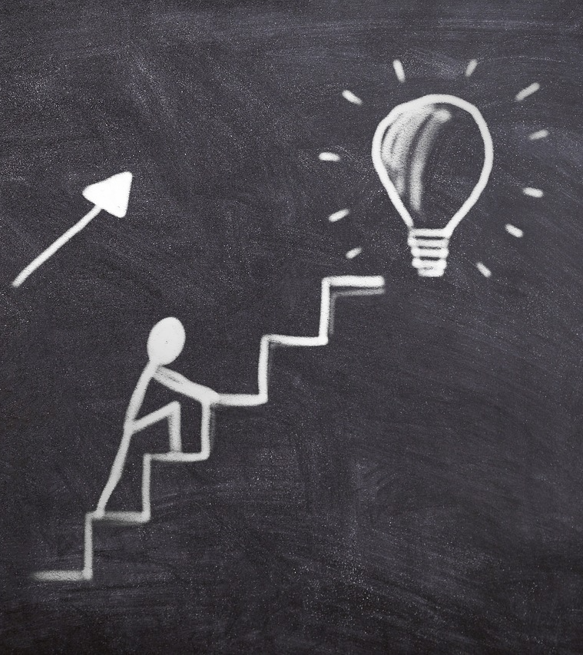
By the end of the lesson, you should be able to:
Identify myths and facts about sexual intercourse, teenage pregnancy, sexual abuse and rape, and discuss how misinformation can affect decision-making.
Explain how values such as respect, abstinence, self-control and privacy can guide responsible decisions about sexuality and lifestyle.
Apply strategies such as saying "no", protecting yourself and taking responsibility when responding to pressure or unsafe situations.
Notes:
Slide 2: By the end of this lesson, you should be able to:
Identify myths and facts about sexual intercourse, teenage pregnancy, sexual abuse and rape, and discuss how misinformation can affect decision-making.
Explain how values such as respect, abstinence, self-control and privacy can guide responsible decisions about sexuality and lifestyle.
Apply strategies such as saying "no", protecting yourself and taking responsibility when responding to pressure or unsafe situations.

Slide 3
Why does this matter?
Many teenagers do not plan for risky situations.
Emotions and peer pressure can influence decisions.
Responsible choices require planning and self-awareness.
Notes:
Slide 3: The topic we are discussing today is serious, and some of you may immediately think, "That will never happen to me."
But do you remember what we discussed in the last lesson about peer pressure and impulsive behaviour? Peer pressure can sometimes happen when you feel pushed into a corner or pressured to make a decision quickly.
Many teenagers who have been interviewed about teenage pregnancy said that they did not plan to get pregnant. Some said, "It just happened," while others said, "I don't know what I was thinking."
It is not always that they did not know that unprotected sex could lead to an unwanted pregnancy. Sometimes they ended up in a situation where feelings became more important than reason.
In this lesson, we will work together to formulate values and strategies that can help you make responsible decisions.

Slide 4

Group Game
Set-up
Place cards face down.
Choose a group leader to spread them out.
How to play
Pick one card and read the statement.
Group votes: Fact or Fiction.
Turn the card over and read the answer.
Continue until everyone has had a turn.
Reflection
Choose TWO facts that surprised or challenged your group.
Discuss why.
Rules
Respect others.
Listen carefully.
No teasing or judging.
Keep discussions appropriate
Notes:
Slide 4: It is important for us to understand what we believe to be true about sexual intercourse, teenage pregnancy, sexual abuse and rape.
Misinformation can influence our decisions and may expose us to risky situations or harmful outcomes.
This game will help you think more carefully about what you believe and whether those beliefs are fact or fiction.
Listen carefully to the instructions.
Teacher to read the instructions on Slide 4. Detailed instructions are available in the Lesson Preparation document.
(Allow 8 minutes for this activity.)

Slide 5
Risky Situations
Risk increases when:
alcohol or drugs affect judgment.
people feel pressured.
boundaries are ignored.
Remember:
Being abused is never the victim's fault.
Responsibility always lies with the perpetrator.
Notes:
Slide 5: I can imagine that some of those cards may have been challenging or surprising to some of you.
Risky behaviours can increase the chance of sexual intercourse and unwanted pregnancy. One example is using drugs or drinking alcohol irresponsibly.
Turn to your peer and briefly discuss the questions in Activity 1 (Lesson 4 – Worksheet).
Answers are available in the Lesson 4 – Worksheet MEMO.
Remember, any situation becomes riskier when a person is under the influence, because the brain does not function clearly. This can lead to poor judgment and fewer inhibitions. Sadly, once the drugs or alcohol wear off, a person may remember what happened, or may not remember clearly, and may feel guilty or confused about their choices.
Substance abuse can also make a person more vulnerable to sexual abuse or rape because it may affect their ability to think clearly, give consent, recognise danger or leave an unsafe situation. However, being under the influence never makes someone responsible for being abused. The person who harms or pressures another person is always responsible for their actions.
This is why it is so important to have clear values and strategies that guide your behaviour and protect you from risky situations.

Slide 6
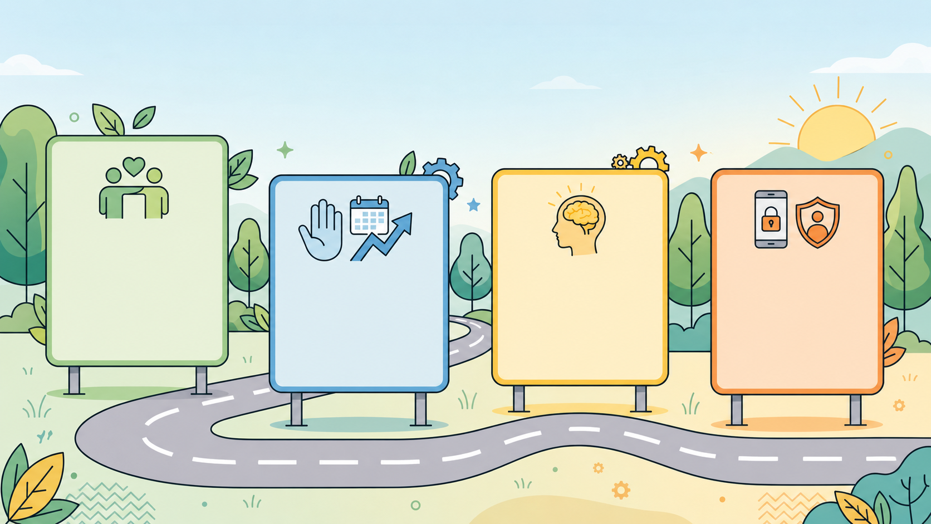
Values as Guardrails
Values help guide decisions:
Respect for self and others
Self-control
Right to privacy
Abstinence
Notes:
Slide 6: Imagine the railings or guardrails on the side of a road. They help protect you while driving and warn you when you are moving into danger. When you notice the warning, you know you need to get back on the road.
In the same way, values can act like guardrails in your life. They can help protect you from risky behaviour and guide you back to responsible choices. Let’s look at some of these values in detail.
Respect for self and others: If you value yourself, you will not accept people treating you as an object. Respecting others also means that you never pressure someone into doing something they are not comfortable with.
Abstinence: Abstinence means choosing not to engage in sex at all. It is a 100% effective way to prevent pregnancy and STIs while you focus on your personal goals.
Self-control: Self-control is like the “pause button” for your brain. It is the ability to stop and think about the possible consequences before acting on a feeling.
The right to privacy: You have the right to keep your body and your digital life private. You do not owe anyone access to your phone, your body or your personal information.

Slide 7
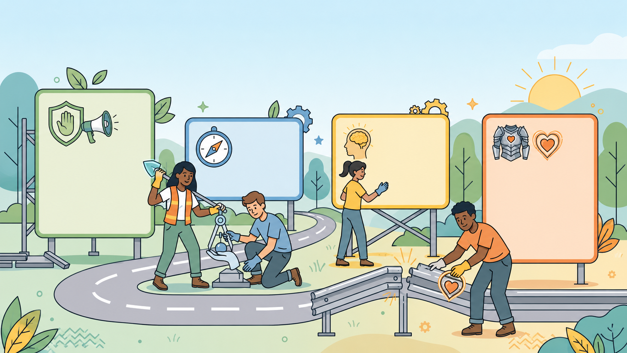
Strategies for Protection
Take responsibility for your choices.
Protect yourself and your boundaries.
Say “no” clearly.
Seek help from trusted adults when needed.
Notes:
Slide 7: In the same way that values are like guardrails, strategies are the tools we use to keep our lives on the road.
The right to say "no": Saying "no" is not just a suggestion. It is your legal and personal right. Use a firm voice and clear body language. You do not need to make an excuse. "No" is a complete sentence.
Taking responsibility: Taking responsibility means owning your actions. If you make a mistake, you take steps to fix it instead of blaming others.
Protecting yourself: Protecting yourself includes being aware of your surroundings, avoiding unsafe situations where possible, and knowing your legal rights regarding consent. It also means recognising warning signs, such as someone ignoring your boundaries, pressuring you, isolating you from friends or refusing to accept "no". If this happens, move away from the situation and speak to a trusted adult or report it.

Slide 8
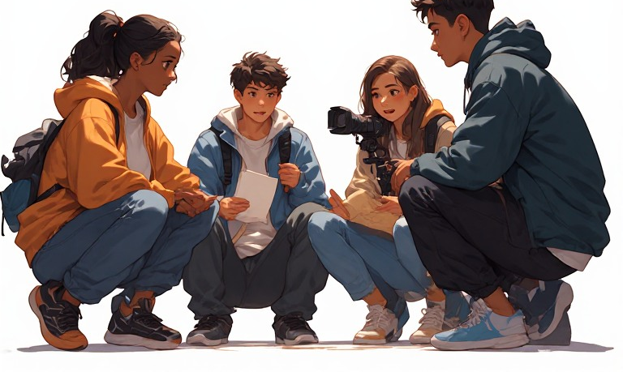
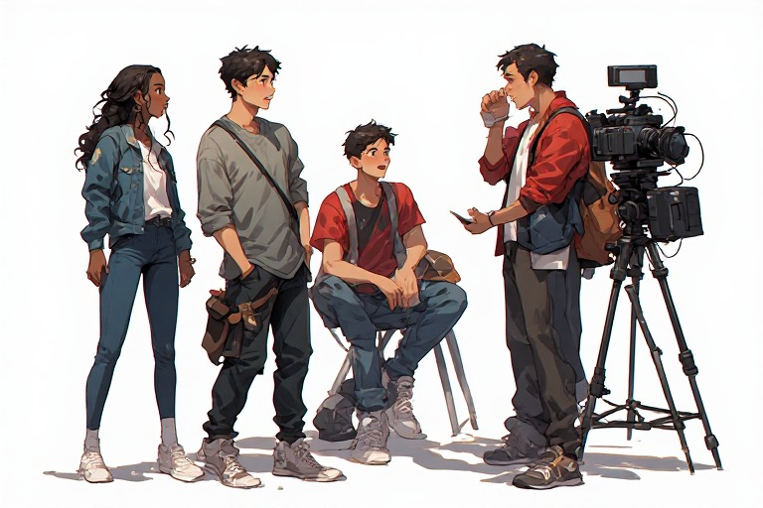
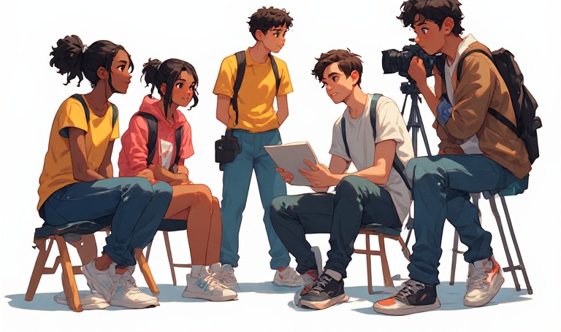
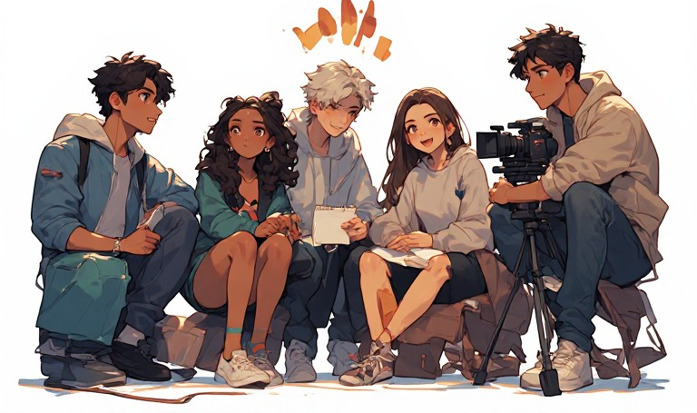
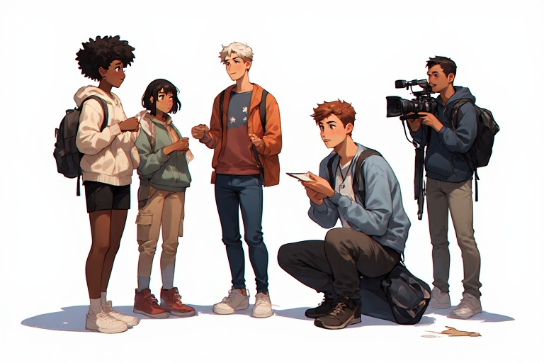

Role-play
Notes:
Note to teacher: Role playing can be a highly effective teaching method. However, teachers need to stay engaged, discourage mocking and watch for learners who may be triggered by the scenarios.
Hand out one scenario with role-play instructions to each group (Lesson 4 – Group Role Play).
Each group will have 10 minutes to discuss and plan their role-play by working through Parts 1–3. Encourage learners to work quickly and keep a close eye on the time so that there are 5 minutes for presentations.
After each role-play, briefly ask the class:
Was the “No” clear and respectful?
Which value was strongest in that response?
Slide 8: It is time to see who the actors and actresses are in the class. Each group has received a role-play instruction sheet. As a group, work through Parts 1–3 together.
You will need to work quickly and plan well, as you only have 10 minutes before the groups present to the class.
Once your group has presented, hand in your planning worksheet. It will be added to the Gallery Wall.

Slide 9

Reflection
Notes:
Well done, Grade 10s. I am so impressed. We have some serious talent in this class.
We only have a few minutes left of the lesson. Complete the question in Activity 2 (Lesson 4 –Worksheet).
Assign Activity 3 (Lesson 4 – Worksheet) as a homework activity. This activity challenges learners to answer exam-type questions.
Share the Lesson 4 – Worksheet MEMO with learners to mark their own answers or make time in this lesson or the next to mark it together.

