Slide 1
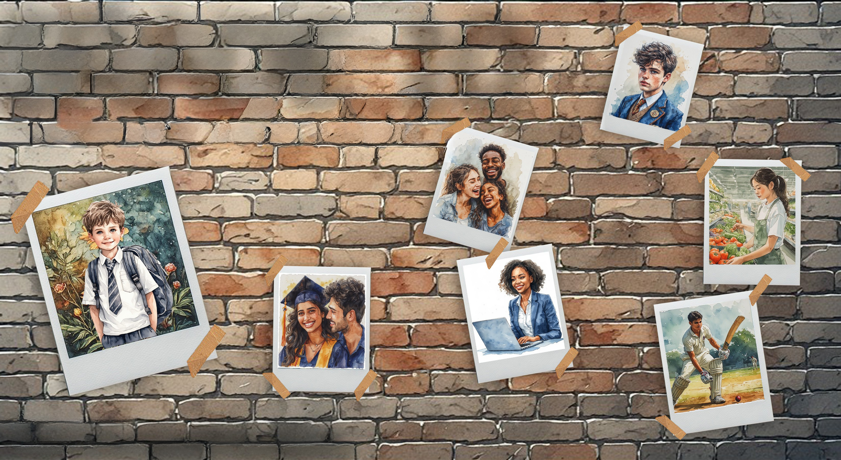

GRADE 10
Development of the Self in Society
Term 3
Lesson 1: Life roles and responsibilities
Notes:
Note to teacher: Make sure the class is divided into groups of four. Each group should also be divided into pairs.
Slide 1: Welcome back to a new term. For the next seven weeks, we will return to Development of the Self in Society.
Sometimes we forget how much we have changed in the past year. We may think that not much has changed until we try to put on a favourite jersey from last year and it no longer fits. Just as physical changes are part of growing older, other changes also take place, such as having new needs and responsibilities that you did not have as a young child.
Throughout our lives, we take on different roles.

Slide 2

By the end of this lesson, you should be able to:
Identify and analyse life roles and responsibilities as learner, family member, friend, partner, etc.
Determine the changing nature of life roles.
Explain how role changes affect relationships.
Explain how society, culture and media can influence life roles.
Notes:
Slide 2: Today, we are going to look at these possible roles and responsibilities in more depth.
By the end of this lesson, you should be able to:
Identify and analyse life roles and responsibilities as learner, family member, friend, partner, etc.
Determine the changing nature of life roles.
Explain how role changes affect relationships.
Explain how society, culture and media can influence life roles.
Let’s get started.

Slide 3
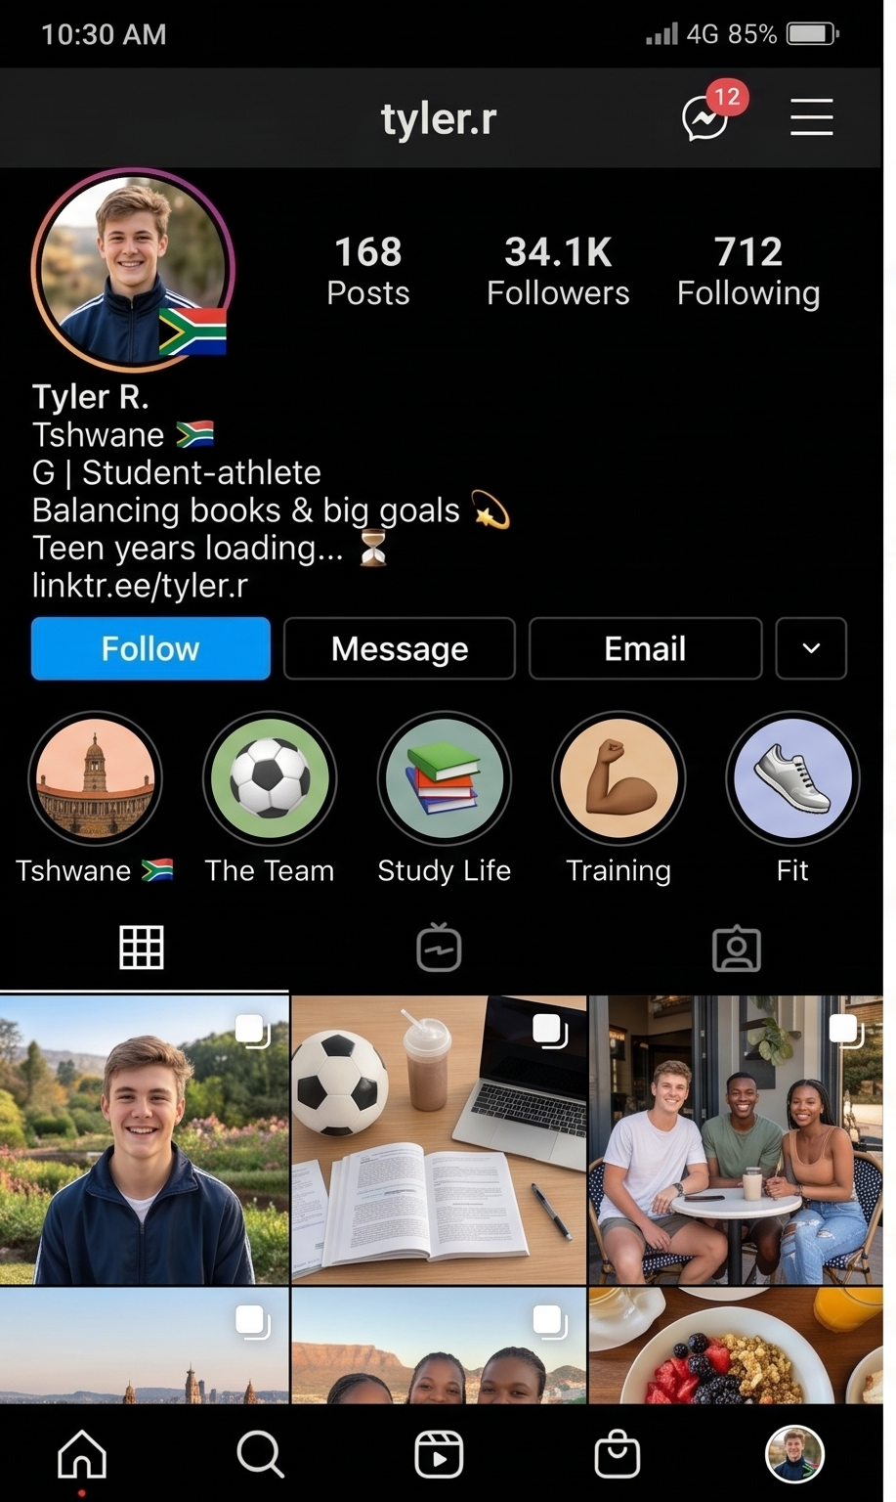
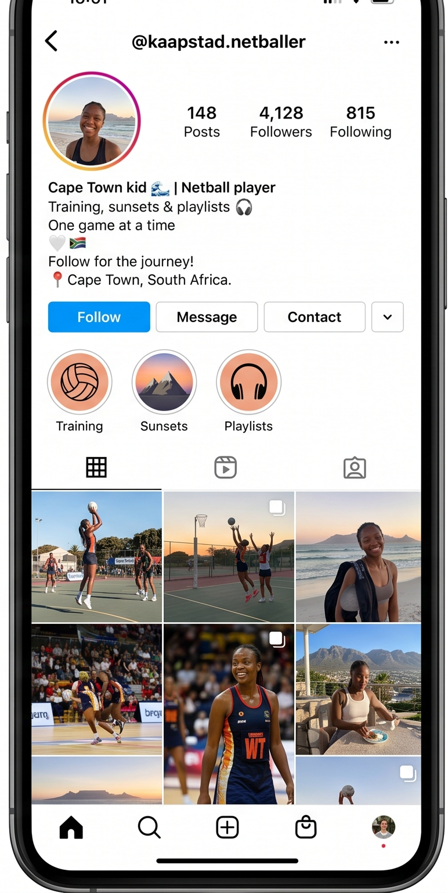
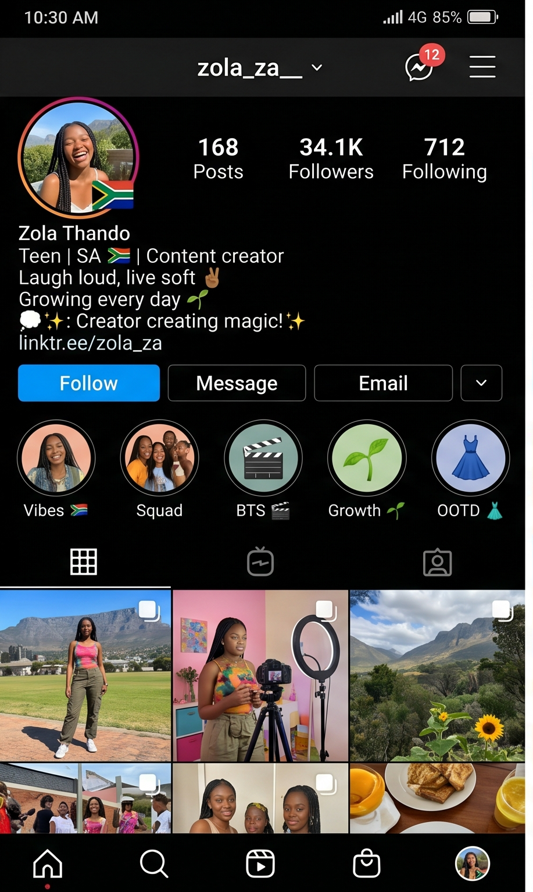
Notes:
Slide 3: When we try to understand the roles we play in society, we first need to ask: “Who am I?” and “What do I do?”
On Slide 3, you will see the Instagram profiles of three different teenagers.
With your peer, briefly discuss the following questions:
Who is the person in the profile?
What does the person in the profile do?
What important information might be missing from this profile?
Well done, class. Would anyone like to share what important information might be missing from these profiles? (Allow learners to respond.)
Social media only gives us a superficial "snapshot" of a person’s life, and even that snapshot can sometimes be fake. Social media does not show all our life roles. We usually see only one part of a person’s life, even though that person may have many different life roles.
So, what is a life role? (Allow learners to respond.)

Slide 4
What is a life role?
A life role is a position or part a person plays in life.
Examples:
learner
family member
friend
partner
employee
Roles and responsibilities change over time.
We can fulfil more than one life role at any given moment.
Notes:
Slide 4: Every person has different roles in life. A life role is the position or part a person plays in society, at home, at school or in relationships. These may include being a young child, student (learner), parent, friend, employee and many others.
These may include being a young child, student (learner), parent, friend, employee and many others.
As people grow older, their roles and responsibilities change. For example, as a young child, you depended on your parents or guardians for most things, and it was your responsibility to listen to them and follow their guidance. As you grow older, you may become more independent and take on new responsibilities, such as helping at home and managing your schoolwork.
We can also fulfil more than one life role at any given moment, for example, a learner may also be a son or daughter, a sibling, a friend, a sports team member, a leader in class, or an employee with a part-time job. Each role comes with certain responsibilities and expectations.

Slide 5

Life Role:
Student (Learner)
attend school regularly and on time
complete homework and assignments
respect teachers and classmates
follow school rules
work hard to prepare for the future
Notes:
Slide 5: Note to teacher: This slide uses animations to help learners follow the discussion on life roles and to prompt class responses. Follow the prompts below.
On Slide 5, we see a teenage boy in the role of a learner (school student). However, he probably has other roles too, such as son, friend or boyfriend. Each of these roles would have different responsibilities.
As a school student, he has the responsibility to:
[Click] attend school regularly and on time,
[Click] complete homework and assignments,
[Click] respect teachers and classmates,
[Click] follow school rules, and
[Click] work hard to prepare for the future.

Slide 6
What are his responsibilities as a family member?
Respect parents, guardians or elders
Help with chores
Support younger siblings
Communicate honestly
Show love and care
One person can have many roles.
Notes:
Slide 6: Now, if we were referring to this same young man’s role as a family member, what might some of his responsibilities be?
Turn to your peer and mention THREE responsibilities each. (Allow 1 minute.)
You may have mentioned some of the following: respecting parents, guardians or elders; helping with chores; supporting younger siblings; communicating honestly; and showing love and care.
As you can see, a learner can also be a son and a friend. In each of these roles, he will have different responsibilities.
Take a moment to complete Activity 1 (Lesson 1 – Worksheet), which focuses on your role as a friend.

Slide 7
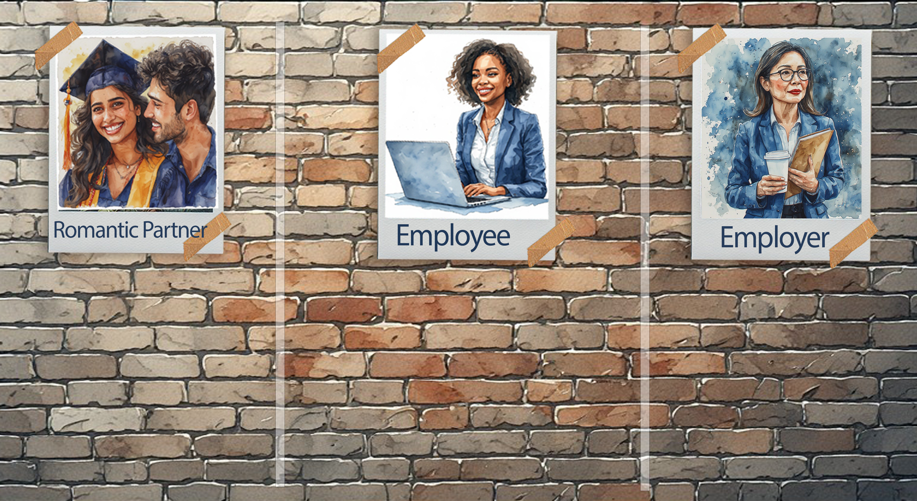
Responsibilities
Responsibilities
Responsibilities
Respect and kindness
Open communication
Personal boundaries
Loyal and honest
Avoiding abusive behaviour
Punctual and reliable
Work hard
Follow instructions
Respect employers
Complete tasks on time
Treat workers fairly
Provide safe working conditions
Pay employees
Respect workers’ rights
Notes:
Slide 7: Note to teacher: This slide uses animations to help learners follow the discussion on life roles and to prompt class responses. Follow the prompts below.
As we mentioned earlier, a person’s roles change as they grow older. You may eventually be in a romantic relationship and take on the role of a partner. In this role, responsibilities would include:
[Click] showing respect and kindness towards one another, communicating openly, respecting consent and personal boundaries, being loyal and honest, and avoiding controlling or abusive behaviour.
When you start applying for jobs, you may take on the role of an employee. This means that you will have responsibilities towards:
[Click] the people you work with and the company.
If you understand these responsibilities, it can help you to be a better employee, evaluate your performance and work on areas where you need to improve. If you do not fulfil these responsibilities, you could lose your job. These responsibilities include being punctual and reliable, following instructions, working hard, respecting employers and co-workers, and completing tasks responsibly.
Hopefully, as you gain experience and develop your skills, you may one day become an employer. In this role, you would provide work for others. You would have the responsibility to:
[Click] treat your workers fairly, provide safe working conditions, pay employees properly and respect workers’ rights.

Slide 8
Leaders and Followers
Leaders
Set a good example
Make fair decisions
Encourage teamwork
Listen to others
Followers
Cooperate
Respect leadership
Contribute positively
Notes:
Slide 8: In every group of people, there are usually leaders and followers. Take a moment to think about some of the school leaders at your school.
Turn to your peer and mention THREE responsibilities you think school leaders should have.
Then, your peer should mention THREE responsibilities that followers, or the rest of the school, should have. (Allow 3 minutes for discussion.)
Well done. You may have mentioned some of the following:
A leader should make fair decisions, set a good example, listen to others, encourage teamwork and take responsibility.
A good follower should cooperate, respect leadership and contribute ideas in a positive way.

Slide 9
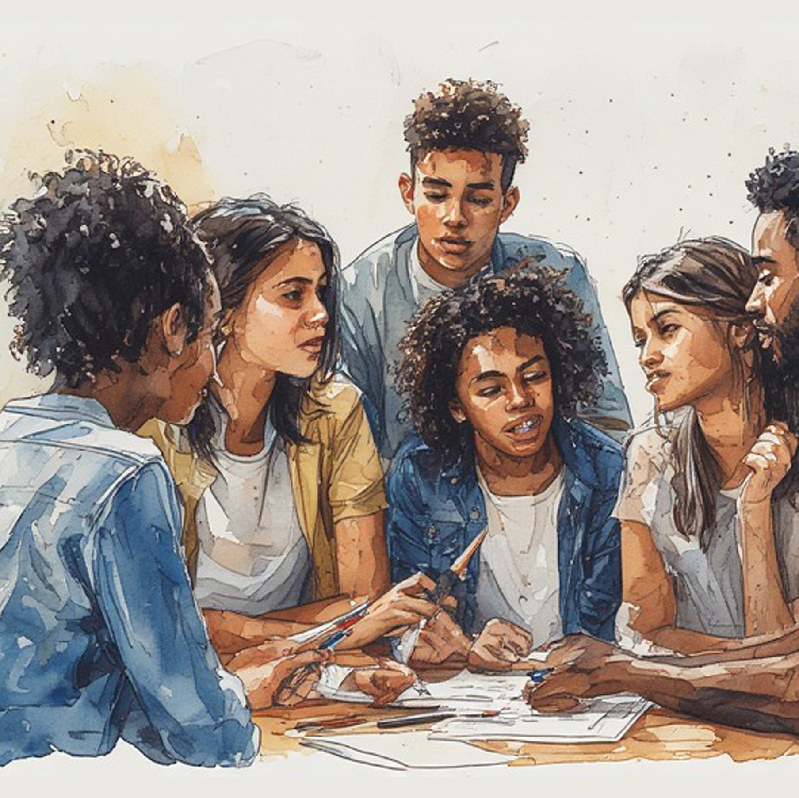
Group Activity
Determine:
  How life roles change
  How responsibilities change
  How relationships are affected
Notes:
Note to teacher: Hand out the Lesson 1 – Group Activity to each group. Groups will read through the text messages and answer the questions on the template provided. As there are only FOUR scenarios, more than one group may have the same scenario.
Allow space for the final templates to be displayed on the classroom wall. Keep this "Gallery Space" available, as it will be added to throughout the lessons.
Slide 9: In your groups, you will now determine the changing nature of life roles and explain how role changes affect relationships.
Each group has received one scenario with a series of text messages. As a group, read through the messages. Then discuss and answer the questions in the space provided next to the text messages.
You will have 10 minutes to complete this activity. Appoint one spokesperson to give feedback using the template at the end of the activity.
Well done, Grade 10s. It is lovely to hear your discussions and see the ideas that have come through.
Possible answers are available in the Lesson 1 – Group Activity MEMO.

Slide 10
Society, Culture and Life Roles
Society influences life roles through:
  Family expectations
  School rules
  Religion
  Media
  Community values
  Traditions
Culture may influence:
  Gender roles
  Respect for elders
  Family responsibilities
  Leadership
  Relationships
Notes:
Slide 10: Society and culture shape how people behave and what is expected from them.
Society influences roles through:
Family expectations
School rules
Religion
Media
Community values
Traditions
For example, in some families, older children are expected to help care for younger siblings or contribute to household responsibilities.
Different cultures may have different expectations about:
Gender roles
Respect for elders
Family responsibilities
Leadership
Relationships
In some cultures, taking part in certain traditions will cause a change in life roles. For example, a Jewish boy will have a Bar Mitzvah at the age of 13, which then defines him as a man.
Can you think of some other examples from your own cultural experiences or traditions that impact life roles? (Allow time for learners to respond.)

Slide 11
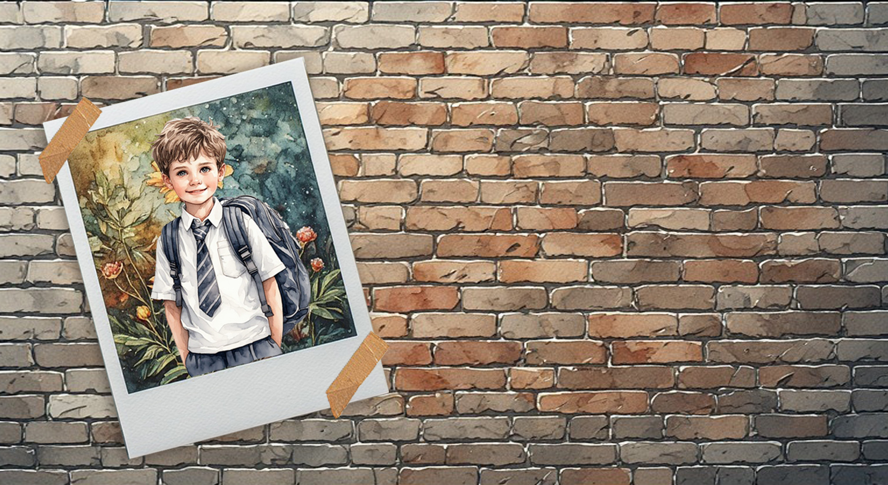
Reflection
Notes:
Slide 11: As we finish off this lesson, read through and answer the questions in Activity 2 (Lesson 1 – Worksheet).

