Slide 1


GRADE 10
Development of the Self in Society
Term 3
Lesson 6: Benefits of positive coping techniques
Notes:
Note to teacher: Make sure the class is divided into groups of four learners. Also assign pairs within each group for pair activities.
Slide 1: Good morning, Grade 10s. Welcome back. In the previous lesson, we learnt about the skills we can use when making choices about sexuality and lifestyle. Can you remember the seven skills?
(Allow learners to respond. Maximum 1 minute.)
Well done. They are: Self-awareness, Critical thinking skills, Decision-making skills, Problem-solving skills, Assertiveness, Negotiation skills and Communication skills.

Slide 2

Peer Discussion
Discuss:
“When you face a stressful or overwhelming situation, what do you do to cope?”
Share:
In pairs: Your strategy
In groups: Your group's best coping strategy
Notes:
Slide 2: Today, we will focus on two ideas that can help make life more manageable: coping with stressful situations and solving everyday problems.
Let’s begin by thinking about how you cope with stress.
Work with your peer in your group of four. I will give you 20 seconds to think about this question:
“When you face a stressful or overwhelming situation, what do you do to cope?”
Share your coping strategy with your peer. (Allow 1 minute.)
Now turn to the other pair in your group and share your coping strategies. Your group should now have four coping strategies. Discuss which one you think is the best. (Allow 2 minutes.)
One learner from each group will share the group’s best coping strategy with the class. (Allow 2 minutes.)
Did you notice that many of you use similar coping strategies, while others have unique ways of managing stress? Some coping strategies may seem helpful at first, but are not helpful in the long run. It is important to develop positive coping strategies that benefit in the long run.

Slide 3

By the end of the lesson, you should be able to:
Distinguish between avoidance, emotion-focused coping and problem-focused coping as responses to stress.
Select appropriate coping strategies for common stressors related to sexuality and lifestyle choices.
Apply problem-solving to work through a challenging scenario.
Notes:
Slide 3: By the end of this lesson, you should be able to:
Distinguish between avoidance, emotion-focused coping and problem-focused coping as responses to stress.
Select appropriate coping strategies for common stressors related to sexuality and lifestyle choices.
Apply problem-solving to work through a challenging scenario.

Slide 4
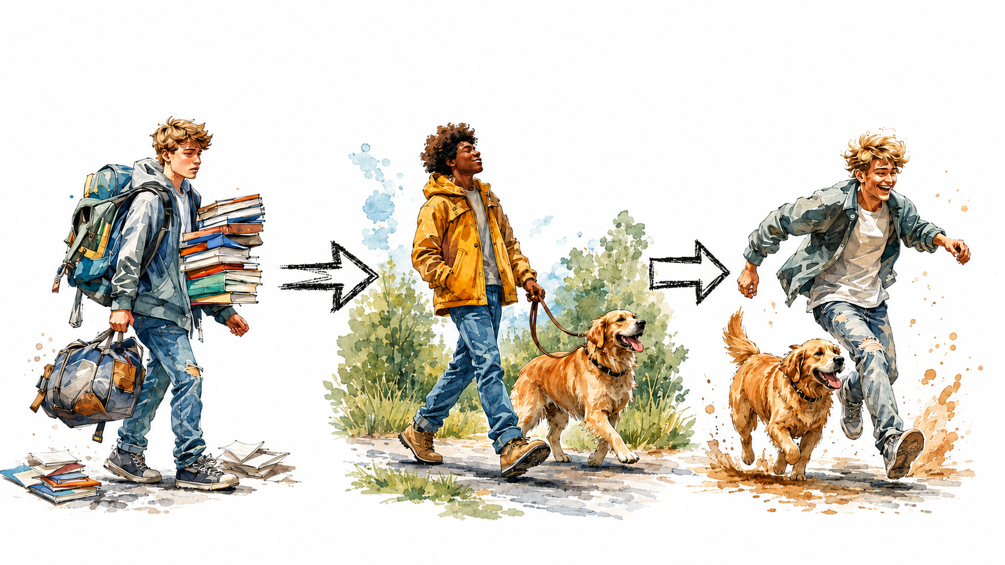
What is a Coping Strategy?
A coping strategy is a systematic way of managing stress or challenges.
Healthy coping strategies:
  reduce stress
  build resilience
  help you deal with future challenges
Notes:
Slide 4: Did you notice how we moved from asking how we cope with stress to talking about "coping strategies"?
A strategy means that we approach a challenge or stress more systematically. A strategy is useful because it can be used in more than one situation and by more than one person. It can also be shared with others and adapted to suit their circumstances.
For example, maybe someone in your group said that they walk their dog for 20 minutes at the end of the day. This may inspire you to go for a walk to cope with the stress of everything that happened during the day.
This brings us to a second point. The goal of strategic thinking is to leave us in a better place than where we started. It helps us become better at dealing with challenges. We call this resilience.
When you face a challenge for the first time, it may feel overwhelming. Think of something you are really good at now. The first time you tried it, you were probably stressed or unsure, but you found a way to improve. Now, the results speak for themselves.
There are many different positive coping strategies. The important thing is to find something healthy that works for you. Not all coping strategies are equally helpful. Some may give quick relief, but create bigger problems later.
It is important to develop healthy coping strategies that help reduce emotional distress or positively manage stressful situations.

Slide 5
Three Coping Strategies
Avoidance
Emotion-focused coping
Problem-focused coping
Not all coping strategies are equally helpful.
Notes:
Slide 5: We will investigate three broad coping strategies that people often use.
Not all coping strategies are helpful, but they may still be the body or mind’s way of trying to deal with stress. By understanding these strategies, we can hopefully learn to choose positive coping mechanisms more often.

Slide 6
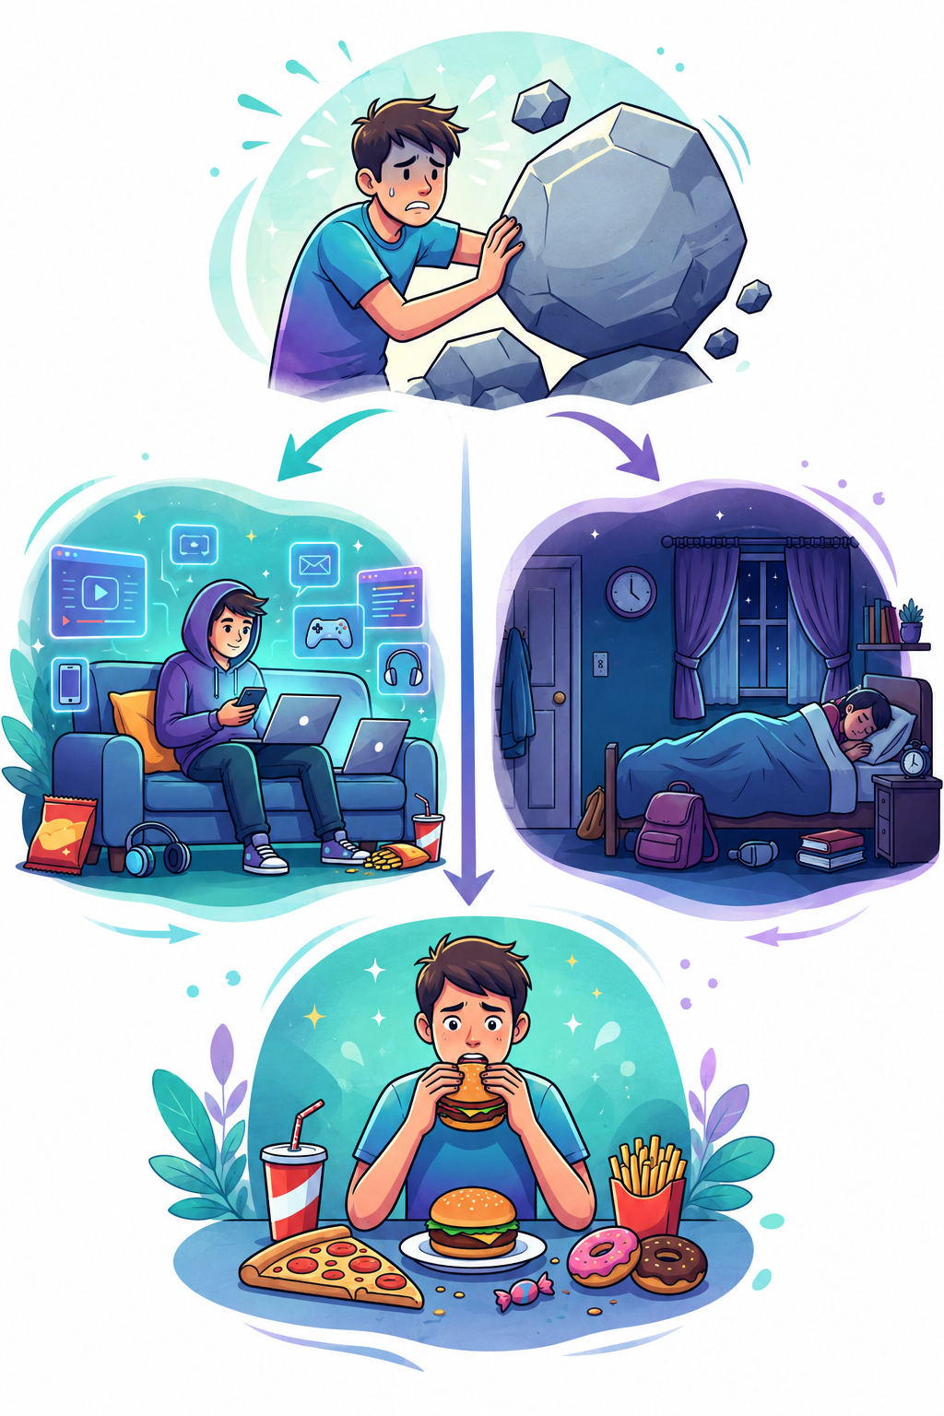
Avoidance
Examples:
Excessive social media or gaming
Sleeping too much
Isolating yourself
Emotional eating
Avoidance provides temporary relief, but often makes problems worse.
Notes:
Slide 6: The first strategy is avoidance.
Have you ever felt like an ostrich that wants to stick its head in the sand and avoid a situation because you feel overwhelmed or stressed? This strategy is often used by teenagers.
Here are some examples of avoidance:
Digital escapism: Binge-watching videos, gaming or endlessly scrolling through social media. A short distraction can give your mind a break, but too much screen time can become a way of avoiding responsibilities.
Behavioural withdrawal: Sleeping too much, skipping school or isolating yourself in your bedroom to avoid the stressor.
Emotional eating: Turning to comfort foods when you feel anxious or overwhelmed, because it gives temporary comfort.
These strategies may seem to offer immediate relief, but the relief is usually temporary. In the long run, avoidance often makes the problem last longer or become worse. This is not a healthy coping strategy.

Slide 7
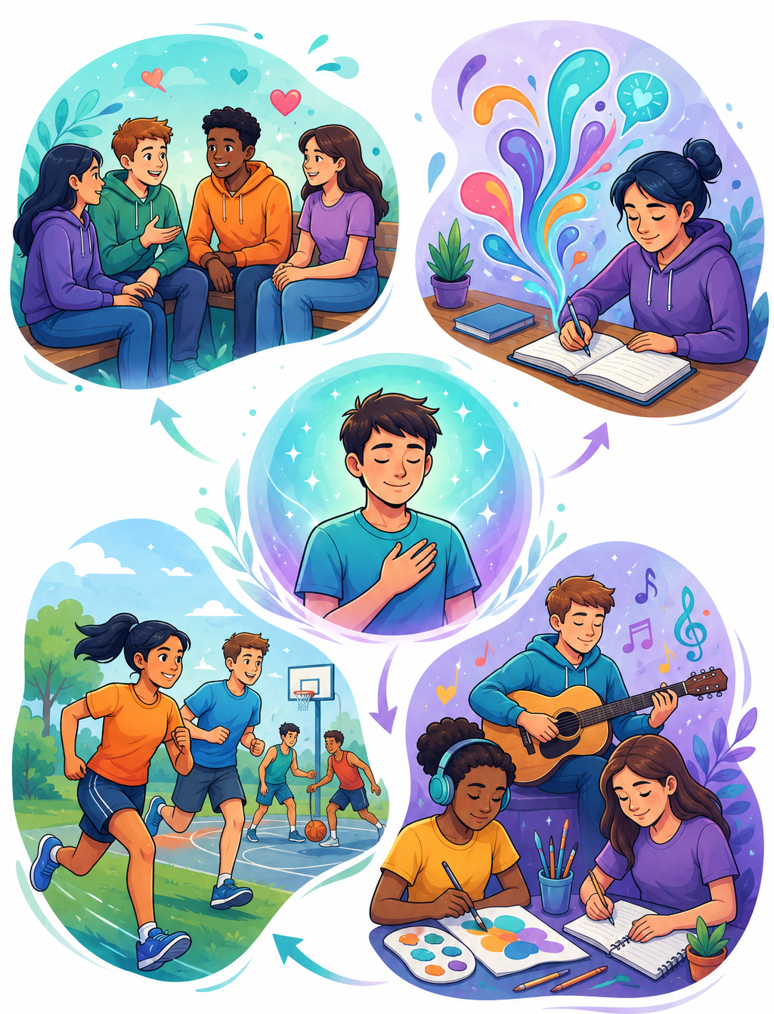
Emotion-Focused Coping
Examples:
Talking to friends
Physical activity
Music or creative activities
Journaling
Helps manage emotional distress.
Notes:
Slide 7: Another coping strategy is emotion-focused coping.
When teenagers feel that they cannot change the stressful situation itself, they may focus on managing the emotional distress caused by the situation. This is a much healthier coping strategy than avoidance.
Some examples include:
Social connection: Talking to friends or seeking comfort from peers. Peer support is important because teenagers often feel that their friends understand their immediate experiences.
Physical and creative outlets: Using physical or creative activities to release stress, frustration or anxiety. Examples include running, playing team sports, listening to or creating music, and creative writing.
Journaling and reflection: Writing down thoughts and feelings to process intense emotions. This can help prevent feeling mentally overloaded.

Slide 8
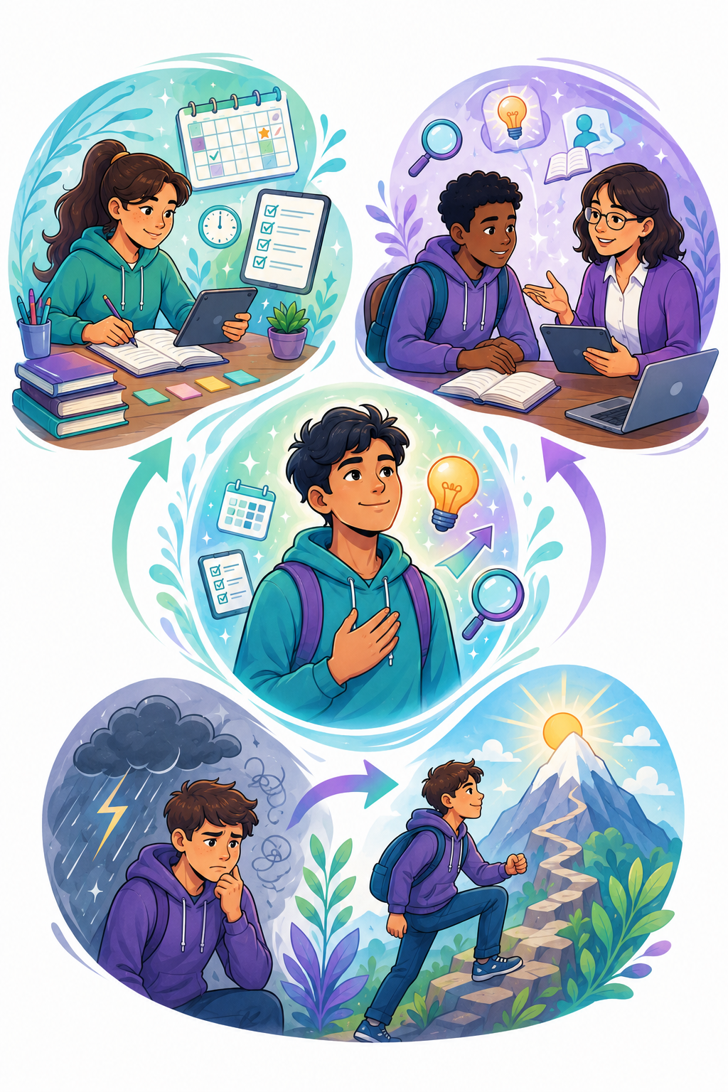
Problem-Focused Coping
Examples:
Planning and time management
Seeking information or help
Cognitive reframing
Focuses on changing or managing the source of stress.
Notes:
Slide 8: The last coping strategy is called problem-focused coping.
This is when you actively try to manage or change the source of the stress. When we feel that we have some control over a situation, we are more likely to use strategies like these:
Time management and planning: Breaking large tasks, such as exam preparation, into smaller, manageable steps. This may include using a study timetable, to-do list or progress tracker.
Information seeking: Looking for solutions by asking for help or finding reliable information. For example, asking a teacher to explain a difficult concept, researching career options or getting advice from a trusted mentor.
Cognitive reframing: Changing the way you think about a stressful situation. Instead of seeing it as an impossible threat, you try to see it as a challenge that can be managed or overcome.
I am sure you can relate to using some of these coping strategies at different times.
You will now have a chance to reflect with your group on which coping strategies you think are the most helpful.

Slide 9
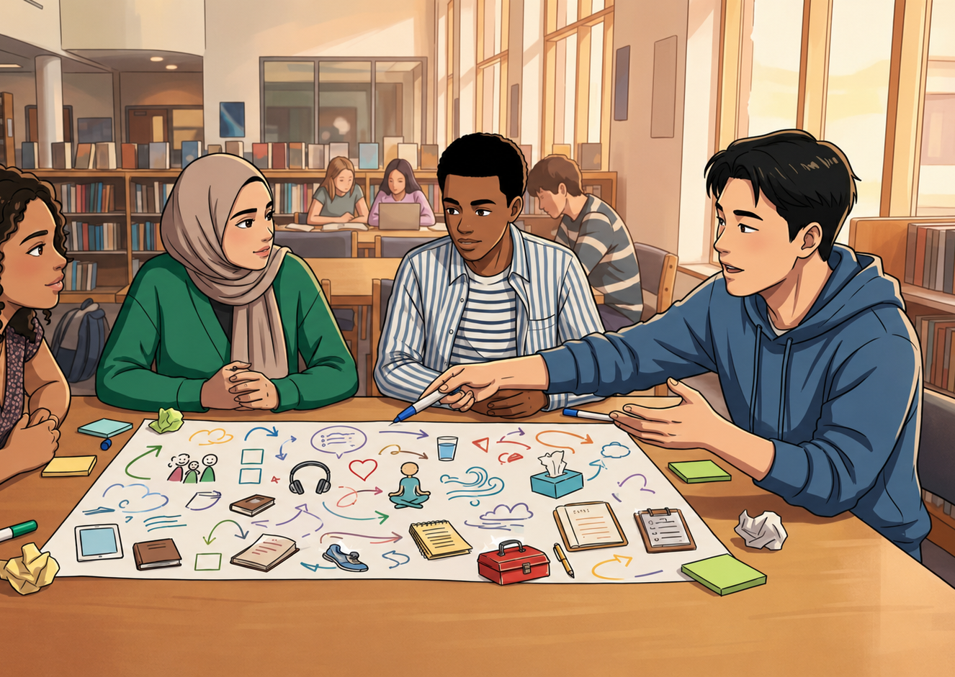
Group Activity
Healthy coping skills may include:
  setting boundaries
  relaxation strategies
  physical activity
  goal-setting and planning
Notes:
Note to teacher: This group activity will take place in groups of four. In pairs, learners will try to solve all the "problems" by following the instructions.
All the "problems" focus on issues teenagers may experience in relation to sexuality or lifestyle choices. Pairs will have 10 minutes to work through the activity. After the discussion, each pair will present a summary to the other pair within their group.
Scenarios or role-plays from previous lessons, such as the Lesson 4 – Group Activity, may also be used as "problems" in this activity.
Slide 9: Learners to complete Activity 1 (Lesson 5 – Worksheet).
You will have 10 minutes to complete the activity and 2 minutes to present your solution to the other pair in your group.
Well done, class. It sounds like you came up with some great solutions to these issues.
[Click] After this activity, we can say that healthy coping skills may include:
establishing and maintaining boundaries
practising relaxation strategies such as deep breathing, meditation and mindfulness
getting regular physical activity
making to-do lists and setting goals
Remember, it is up to you to decide which coping strategy is likely to work best for you in your specific situation. These coping strategies can help with lifestyle challenges, such as managing the stress of examinations, but they can also help when you are confronted with issues related to sexuality.
Some of the sexuality and lifestyle choices we have discussed in the last few lessons may have felt overwhelming. Hopefully, you now have a few more positive coping strategies to help you manage these situations.

Slide 10
Problem-Solving Matrix
Step 1
Identify the challenge (Be specific & consider feelings)
Step 2
Explore options and consequences (Brainstorm as many as possible)
Step 3
Decide on actions (Consider people, consent and values for best outcome)
Step 4
Reflect and improve (How would you handle it better in future?)
Notes:
Note to teacher: Leave this slide up while learners complete the activity.
Slide 10: Challenges are a normal part of everyday life. Learning how to solve challenges in a thoughtful and structured way can help you make better decisions and feel more in control.
One useful tool for doing this is the problem-solving matrix.
Step 1: Identify the challenge.
Try to be as specific as possible so that you know what you are dealing with. Do not only think about the situation, but also about the feelings linked to it.
Step 2: Explore options and consequences.
Brainstorm as many possible solutions as you can. Then discuss the possible consequences of each solution. Even if a solution does not seem practical at first, include it. You can always discard it later. Then choose the best solution.
Step 3: Decide what actions need to be taken.
Think about what needs to happen next. Remember, you are looking for a positive outcome. Consider whether other people are involved, whether they have given consent, and whether the action fits your values.
Step 4: Reflect.
After you have tried the solution, reflect on what worked and what needs improvement. If this happened again, what would you change to handle it better?
Let’s see how much you have learnt. Together with your group, complete the problem-solving matrix based on the scenario (Lesson 6 – Scenarios) handed to you by your teacher.
Once complete, hand it in to your teacher so that it can be added to the Gallery Wall.

Slide 11
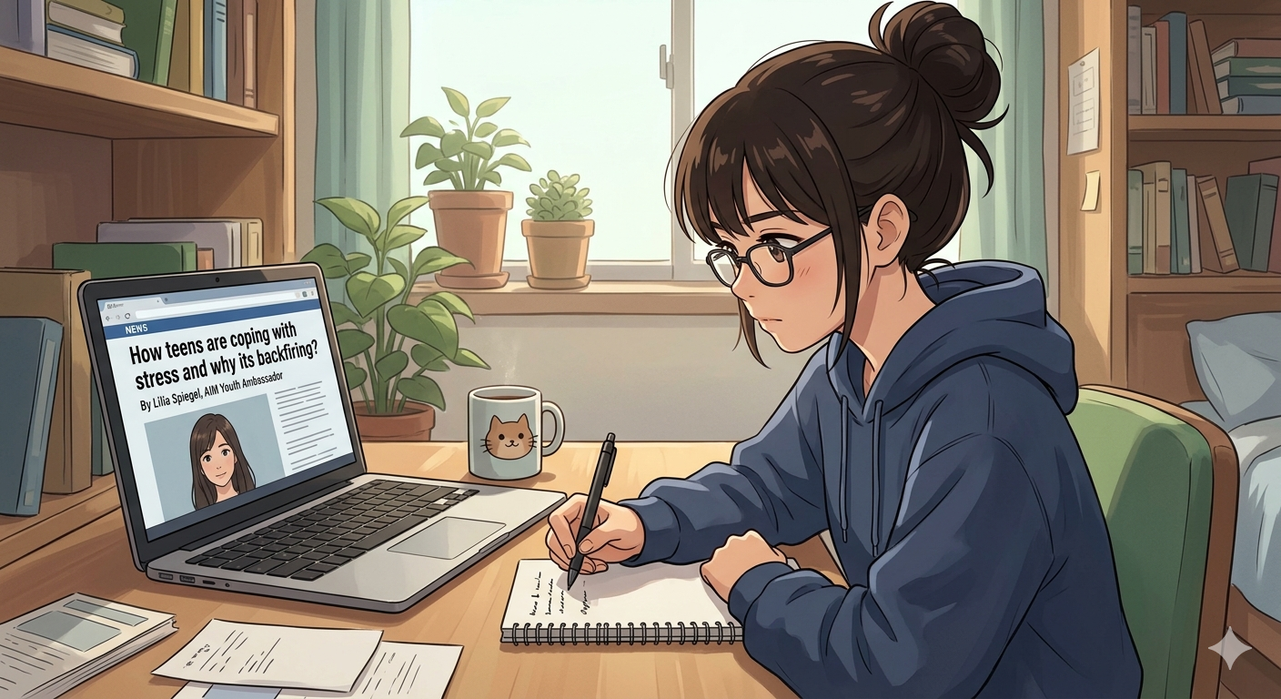
Homework Activity
Notes:
Slide 11: We have covered a lot in this lesson. I hope you now have a better understanding of how to cope with stressful situations.
You will have a few minutes to start Activity 2 (Lesson 6 – Worksheet), but you will need to complete it for homework. These questions will also help you prepare for exam-type questions.
Answers are available in the Lesson 6 – Worksheet MEMO.

Slide 12

Reflection
Notes:
Slide 12: As we finish this lesson, read through and answer the questions in Activity 3 (Lesson 6 –Worksheet).
Don't forget to complete the homework activity to help you prepare for exam-type questions.

