Slide 1
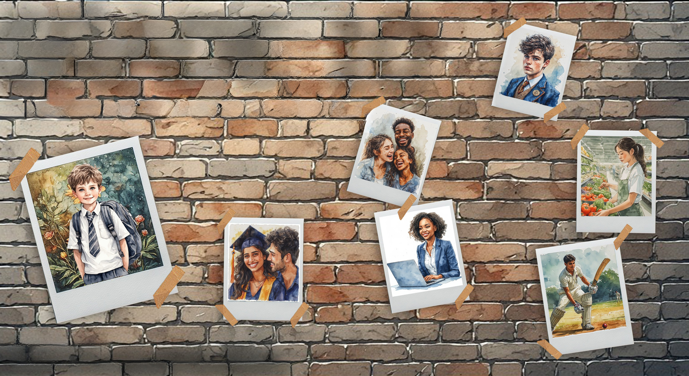

GRADE 10
Development of the Self in Society
Term 3
Lesson 7: Respect for diversity
Notes:
Note to teacher: Divide the class into groups of four for the role-play activity. In preparation for the introduction activity, ensure that the learners have sticky notes and that the Gallery Wall is accessible to learners.
Today’s lesson may be sensitive for some learners. Be aware of learners’ body language and responses. Keep reminding learners that the focus is on accepting and respecting one another, even though we are different. This lesson is not about debating religious or cultural beliefs. It is about people, dignity and respect.
Slide 1: Good morning, Grade 10s. Can you believe we have reached the last lesson in this series on the journey from adolescence to adulthood? We have covered a lot of content over the last six weeks.
Together with your peer, walk through the Gallery Wall and look at the activities your classmates have completed over the last few weeks.
On a sticky note, comment on THREE activities. Your comments should include your personal response to the work or ideas shown. Remember to be positive and self-reflective. (Allow 3 minutes.)
Now discuss ONE coping strategy from the previous lesson with your peer. (Allow 1 minute.)
Today, our focus is on how to respect all people. We will begin by investigating some of the challenges that the LGBTQI+ community may experience in South Africa today.

Slide 2

By the end of the lesson, you should be able to:
Explain why all people deserve respect, regardless of sexual orientation or gender identity.
Define key terms related to sex, gender, sexual orientation and LGBTQIA+ identity.
Use respectful and inclusive language in situations involving identity and diversity.
Identify trusted sources of support and explain how nutrition and exercise support well-being.
Notes:
Slide 2: By the end of this lesson, you should be able to:
Explain why all people deserve respect, regardless of sexual orientation or gender identity.
Define key terms related to sex, gender, sexual orientation and LGBTQIA+ identity.
Use respectful and inclusive language in situations involving identity and diversity.
Identify trusted sources of support and explain how nutrition and exercise support well-being.

Slide 3
Dignity and Respect
SA faces many cases of GBV (including corrective rape).
Many people struggle with the effects of violence due to their gender identity or sexual orientation.
South Africa is a diverse country.
All people deserve dignity and respect.
No one should experience discrimination or violence because of who they are.
Notes:
Slide 3: In the last few years, South Africa has continued to face serious challenges linked to gender-based violence (GBV). This type of violence affects many people and may include assault, sexual abuse and rape.
One harmful form of violence is sometimes called "corrective rape". This refers to the rape of a person because of their sexual orientation or gender identity, often with the false and harmful belief that this can "correct" who they are. Many adolescents may struggle with the effects of this kind of violence, especially when their friends, families or communities do not accept them.
The aim is to understand that we live in a diverse country. We are all different, but we are all human beings. Everyone deserves to be treated with dignity and respect.

Slide 4

Identity
Our identity is made up of many parts, for example:
  interests
  talents
  personality
  culture
  beliefs
  sexual orientation
Notes:
Slide 4: Many characteristics make up our identity. Maybe you love playing sports and are really good at it, or maybe you are someone who loves baking cakes and sharing them with friends. Your friends might describe you as kind, funny or quiet. Just as these words can describe parts of our identity, sexual orientation can also be part of a person’s identity.
Together with your peer, look at the terms on Slide 4. See how many of these terms you can define. Write your agreed definition in Activity 1 (Lesson 7 – Worksheet). Allow 3 minutes.
Note to teacher: Answers are available in the Lesson 7 – Worksheet MEMO, but the answers will be discussed in the following two slides.

Slide 5
Respecting Diversity
Identity can be complex.
Everyone's experiences are unique.
Respecting diversity means treating all people with dignity.
Notes:
Slide 5: Remember, the change from adolescence to adulthood involves moving beyond "black and white" thinking and understanding that identity can be complex. Respecting diversity means acknowledging that each person’s journey with their body, identity and relationships is individual and should be treated with respect.
Let’s start by looking at the terms you tried to define.

Slide 6
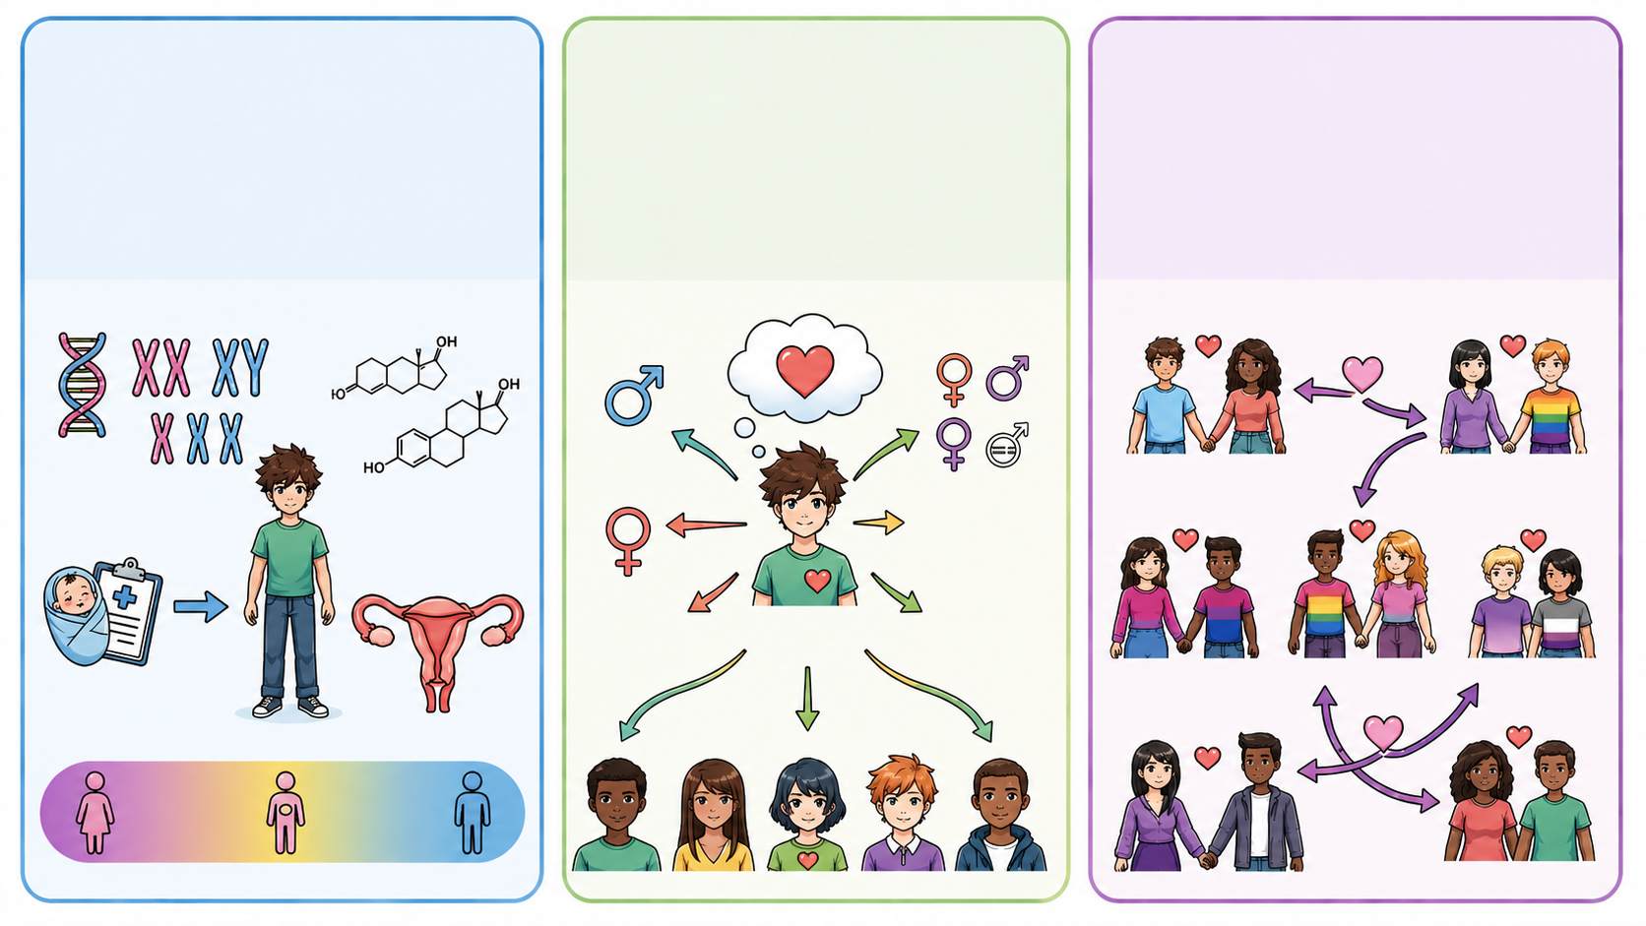
Sex:
Biological characteristics at birth.
Related to chromosomes, hormones and anatomy.
Gender:
How a person experiences and expresses themselves.
Includes societal roles, behaviours and expectations.
Sexual orientation:
Who a person is emotionally, romantically or physically attracted to.
Notes:
Slide 6: Biological sex: Refers to the biological attributes a person is born with, such as chromosomes, hormones and anatomy. These attributes are often used to classify a person as male or female at birth.
Gender: This refers to how a person experiences and expresses themselves as male, female, both or neither. It also includes the roles, behaviours and expectations that society may associate with being male or female.
Sexual orientation: This refers to who a person is attracted to physically, romantically or emotionally.

Slide 7
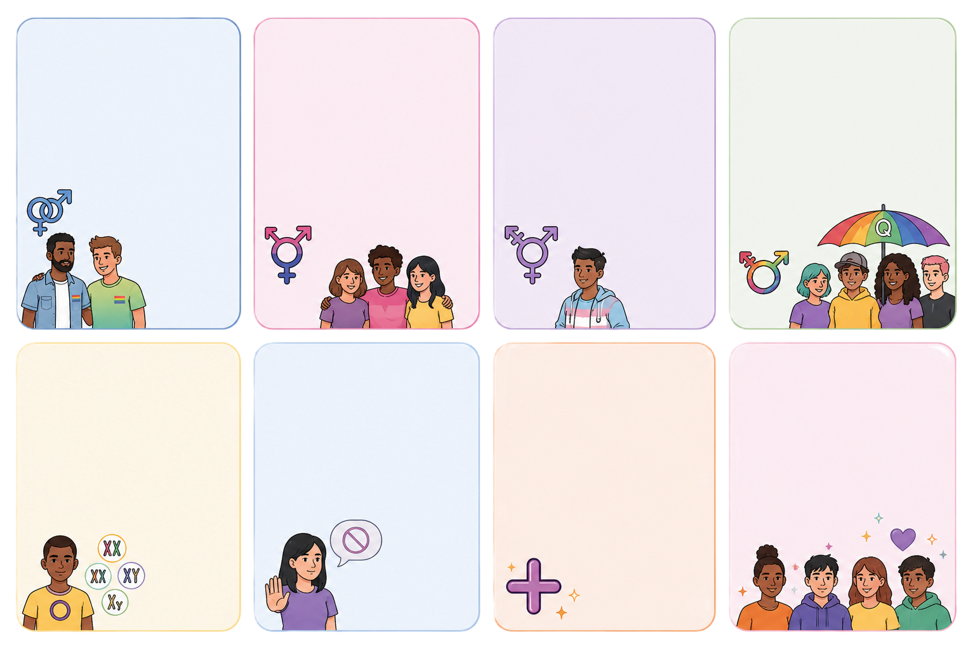
Lesbian: Women who are attracted to other women.
Gay: Men who are attracted to other men.
Queer:
A broad term for sexual orientations or gender identities that do not necessarily fit traditional ideas about sexuality or gender.
Transgender:
A person whose gender identity is not the same as the sex registered for them at birth.
Bisexual:
Men and women who are attracted to both women and men.
Intersex:
A person who is born with biological sex characteristics that do not fit within typical male or female categories.
Asexual:
Having little or no sexual attraction to others.
LGBTQIA+ is an un umbrella term for different sexual orientations and gender identities.
+ Plus:
More, or additional, genders and sexual orientations.
Notes:
Slide 7: The term LGBTQIA+ is an un umbrella term for different sexual orientations and gender identities. The abbreviation stands for lesbian, gay, bisexual, transgender, queer or questioning, intersex, asexual and more. If you remember the letters, it becomes easier to understand what each part of the term refers to.
Lesbian: Relating to women who are attracted exclusively to other women.
Gay: Relating to men who are attracted exclusively to other men.
Bisexual: Relating to men and women who are attracted to both women and men.
Queer: A broad term for sexual orientations or gender identities that do not necessarily fit traditional ideas about sexuality or gender. It is often used by people who don't want a specific label.
Transgender: A person whose gender identity is not the same as the sex registered for them at birth.
Intersex: A person who is born with biological sex characteristics that do not fit within typical male or female categories.
Asexual: Relating to having little or no sexual attraction to others.
+ Plus: More, or additional, genders and sexual orientations.
Together with your peer, complete Activity 2 (Lesson 7 – Worksheet). Discuss the examples carefully and connect only one example to each term. (Allow 4 minutes.)
Answers are available in the Lesson 7 – Worksheet MEMO.

Slide 8
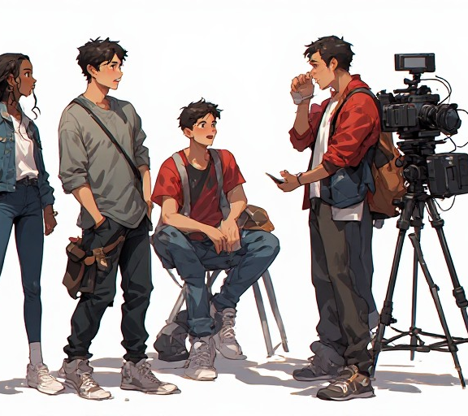
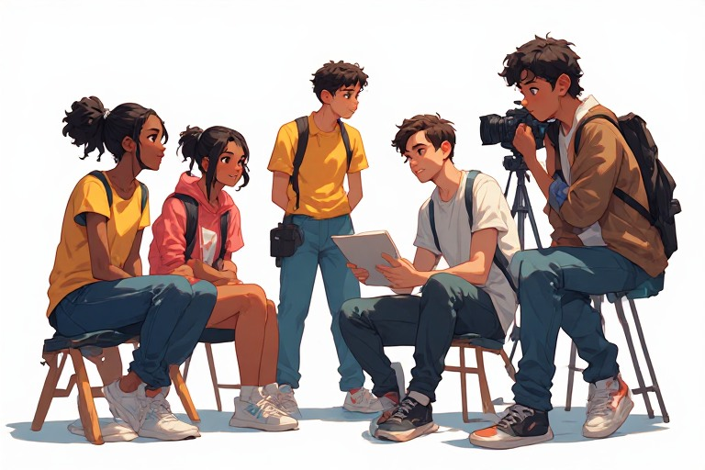
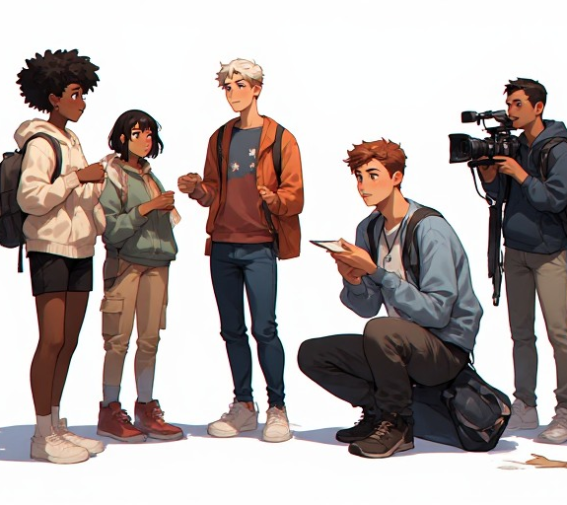
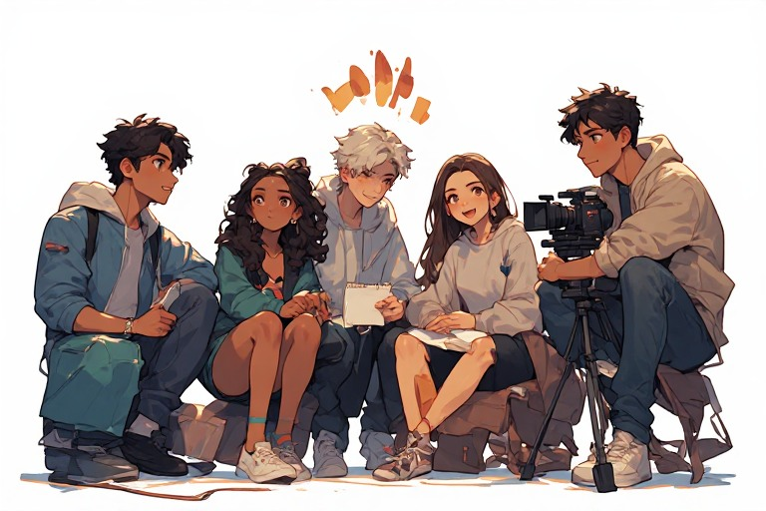
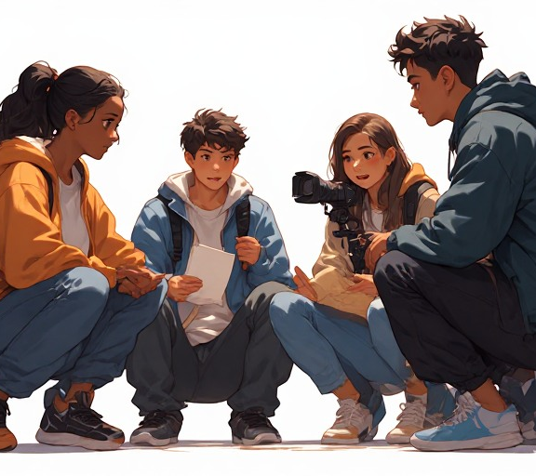
Group Activity
Read the script.
Discuss why the behaviour is harmful.
Rewrite the dialogue respectfully.
Present your improved version.
Notes:
Note to teacher: This activity may seem very simple. This is intentional, because learners often do not think carefully about what they say in the moment, and some phrases may be hurtful to others.
Divide the class into groups of four learners. Arrange the groups so that Group 1 and Group 2 can present to each other for the second part of the activity. Each group is assigned a different role-play scenario from the Lesson 7 – Group Activity document.
Explain that each group must first read the scenario exactly as written. They should then discuss how the character being disrespected might feel and why the behaviour is harmful. Next, they should work together to rewrite the dialogue to show respectful and inclusive behaviour. Finally, each group will act out their improved "respectful version" to their partner group, followed by brief feedback.
Slide 8: You might think that you are not the kind of person who would be disrespectful to people with different sexual orientations or identities. However, sometimes we do not realise that what we say can hurt the people around us.
Each group has received a script (Lesson 7 – Group Activity). Follow the instructions carefully.
You will have 10 minutes to complete Part 1.
After that, your group will present your rephrased script to your partner group. Each group will have 1 minute to present.
Well done, everyone. I enjoyed hearing how each group changed the script. It was good to hear such respectful language from each of you.

Slide 9
Sources of Support
Trusted sources include:
parents and caregivers
teachers and school counsellors
doctors and clinics
social workers and psychologists
community organisations
Seek help from reliable sources.
Notes:
Slide 9: As teenagers, you may sometimes feel confused, stressed or worried about sexuality, relationships, identity or lifestyle choices.
Sources of support include:
Trusted parents, caregivers or family members
Teachers, school counsellors and life orientation teachers
Doctors, nurses and local clinics
Social workers and psychologists
Community organisations and youth groups
You should avoid relying only on social media for advice. Information should come from trusted and reliable sources.

Slide 10
Looking After Your Well-being
Nutrition
Eat a balanced diet.
Drink enough water.
Exercise
Cardio
Strength
Balance
Stretching
Healthy bodies support healthy minds.
Notes:
Slide 10: Making healthy lifestyle choices is not only about making responsible decisions about your sexuality and emotions. We also need to look after our bodies by exercising regularly and eating in a balanced way.
Nutrition is the process of giving the body the food and nutrients it needs to grow, stay healthy, have energy and function properly. A balanced diet should include carbohydrates, proteins, healthy fats, fruit, vegetables and enough water.
A balanced exercise programme should include different types of movement during the week:
Cardio: Exercise that gets your heart rate up and blood flowing, such as running, cycling or dancing.
Strength: Exercise that develops muscle strength and helps prevent injuries, such as body-weight exercises or gym training.
Balance: Exercise that strengthens the core and helps stabilise muscle groups, such as yoga or balance exercises.
Stretching: Gentle stretching after exercise can help your muscles recover, improve flexibility and reduce stiffness.

Slide 11
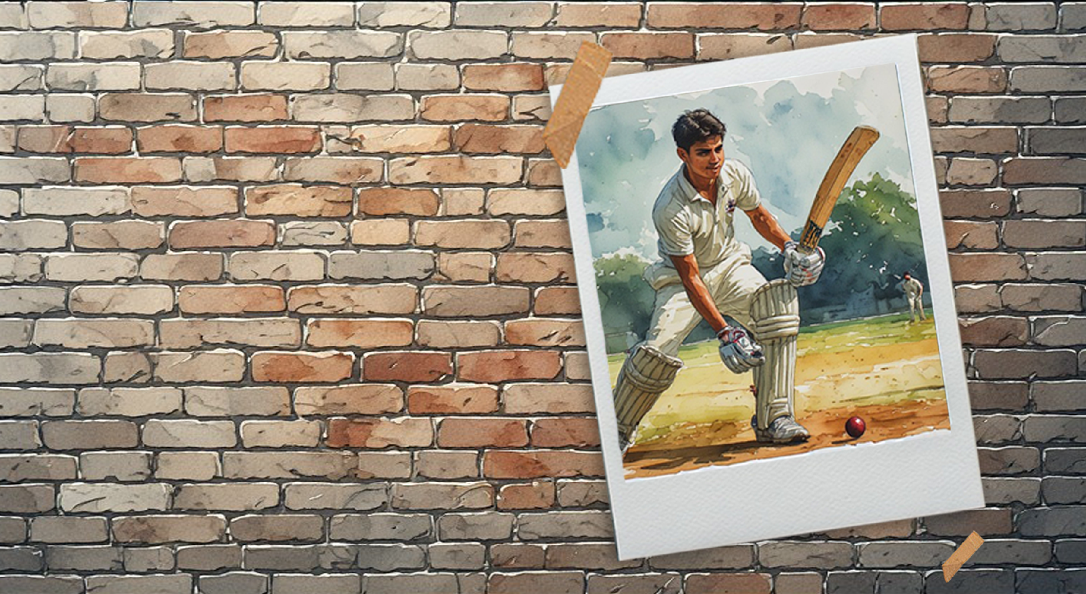
Reflection
Notes:
Slide 11: We have come to the end of this series of lessons.
Learners to complete the brief reflection in Activity 3 (Lesson 7 – Worksheet).
Hand out the Content Summary.

